Slide 1
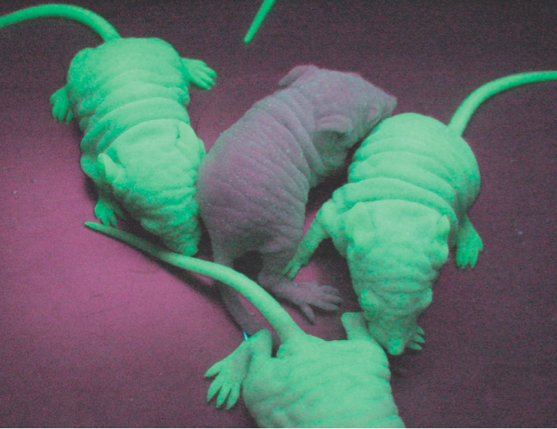
Chapter 16 - Biotechnology
Gene causes these mice to glow in the dark. Normally, the gene is found in jellyfish.

Slide 2
BIOETHICS SURVEY
1. I would use genetic engineering to remove a harmful gene from my unborn child, such as the gene that causes cystic fibrosis.
1 ------ 2 ----- 3 ----- 4 ----- 5 definitely not --------------> absolutely
2. I would use genetic engineering to remove an abnormal (but not necessarily harmful) gene from my unborn child; such as the gene that causes dwarfism.
1 ------ 2 ----- 3 ----- 4 ----- 5 definitely not --------------> absolutely

Slide 3
3. I would use genetic engineering to remove a gene that is not desirable, such as the gene that causes baldness.
1 ------ 2 ----- 3 ----- 4 ----- 5 definitely not --------------> absolutely
4. I would use genetic engineering to change a gene in my unborn child, such as their hair color or eye color.
5. I would use genetic engineering to add a gene to my child that is not human – such as a gene from another organism that could improve sight or running ability.

Slide 4
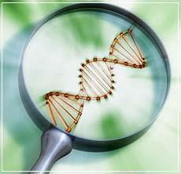
BIOTECHNOLOGY
Recombinant DNA Technology / Transgenic
Gene Sequencing (Human Genome Project)
Gene Cloning / Cloning
Stem Cell Research
Gene Therapy
DNA Fingerprinting (and other Forensics applications)

Slide 5
RECOMBINANT DNA TECHNOLOGY
DNA from different sources is combined
Materials Needed:
Vector (plasmid)
Restriction Enzyme
DNA ligase

Slide 6
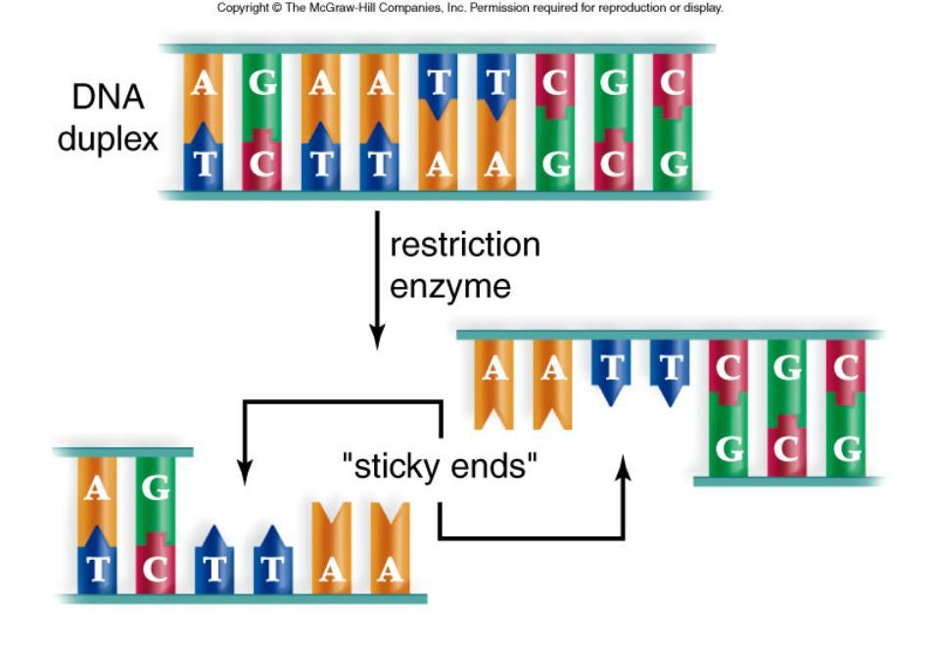
Pg 268

Slide 7
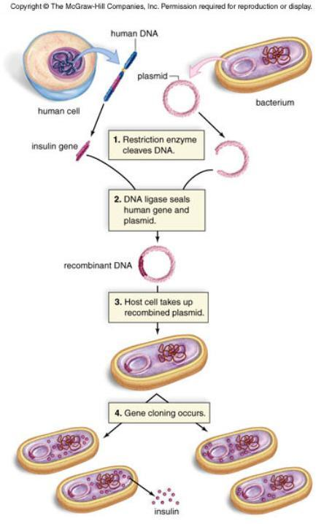
RECOMBINANT DNA *Can allow us to take a human gene and place it into bacteria. The bacteria can now produce human proteins (hormones, clotting factor, insulin..etc…)

Slide 8
The Polymerase Chain Reaction (PCR)
Creates millions of copies of a gene (or segment of DNA
Uses DNA Polymerase to copy segments
DNA must be heated to separate strands.
GENE AMPLIFICATION

Slide 9
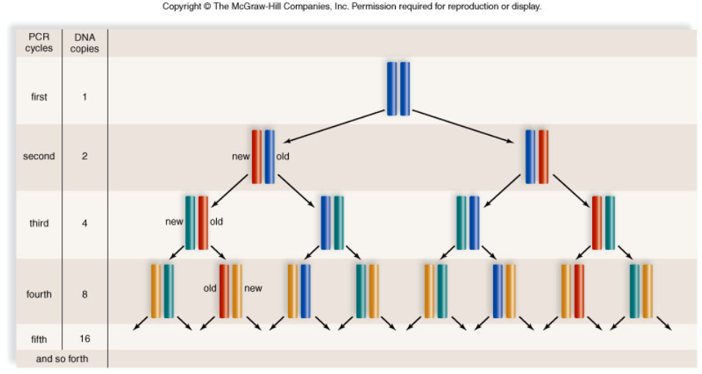
Polymerase Chain Reaction

Slide 10
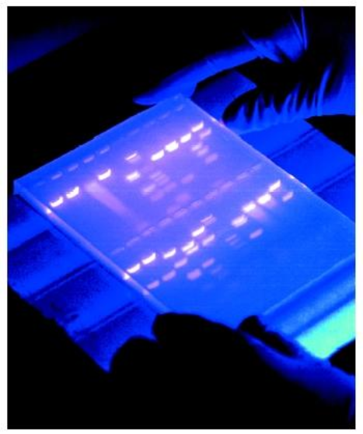
DNA ANALYSIS
Get sample
Cut with restriction enzymes
Apply to wells in gel
Add electricity
Fragments move

Slide 11
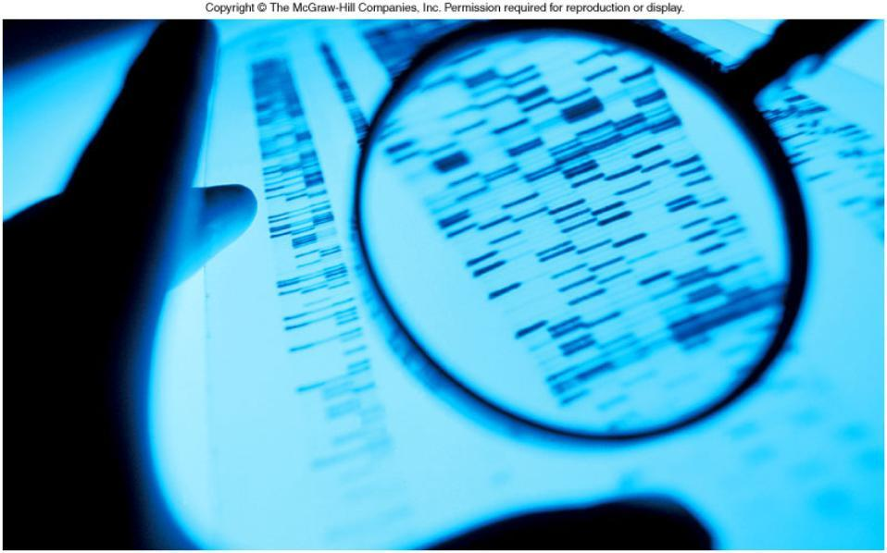
Pg 274b

Slide 12
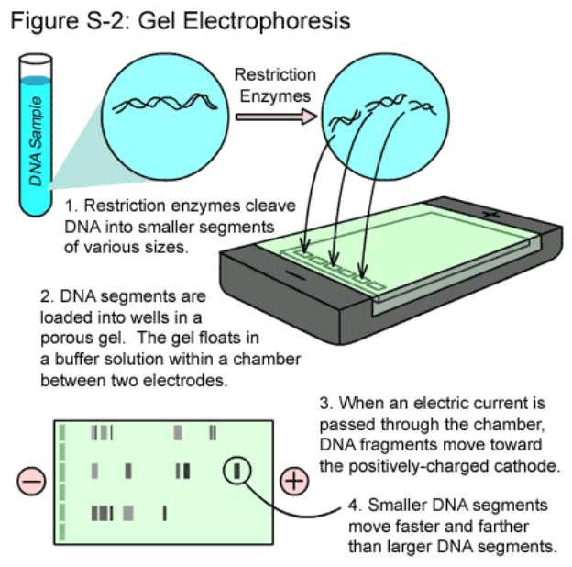

Slide 13
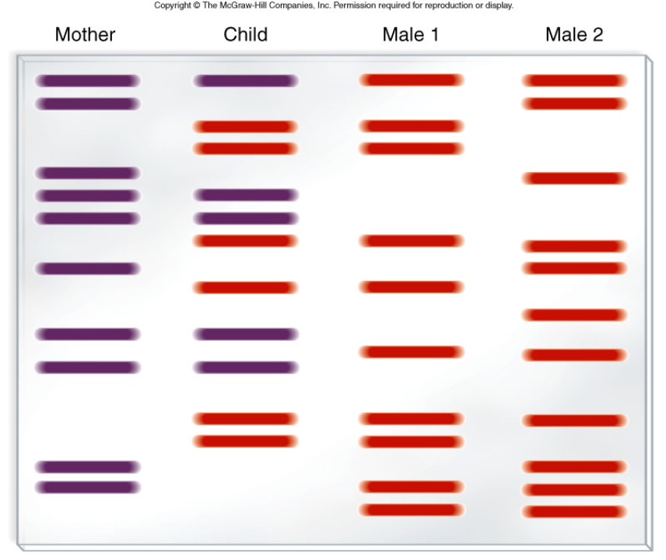
Figure 16.3

Slide 14
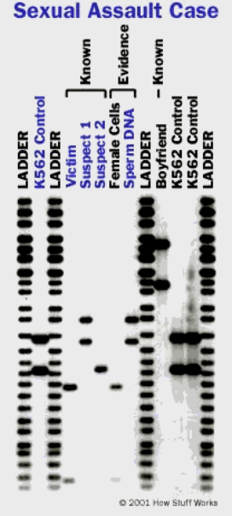
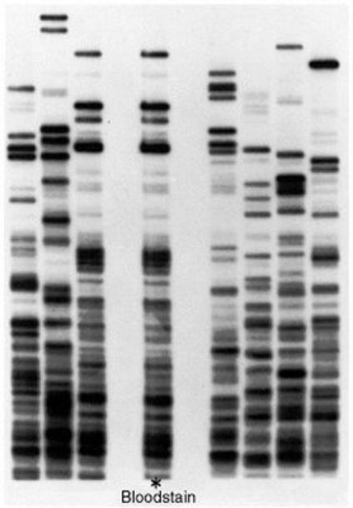

Slide 15
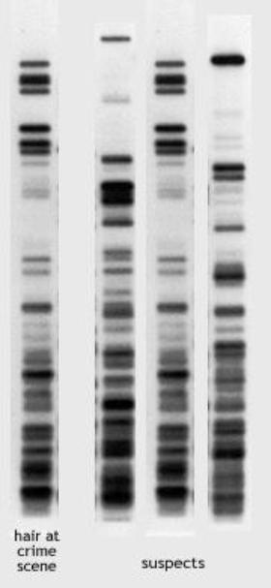

Slide 16
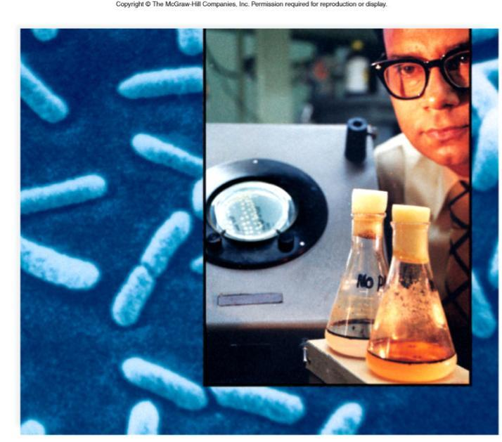
Biotechnology Products

Slide 17
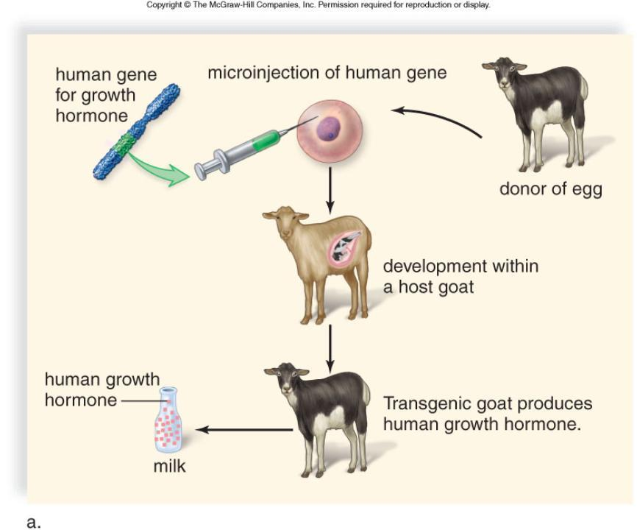
Figure 16.5a

Slide 18
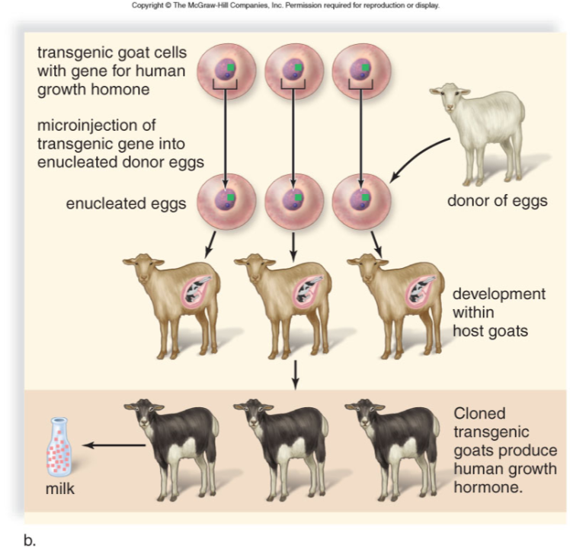
Figure 16.5b

Slide 19
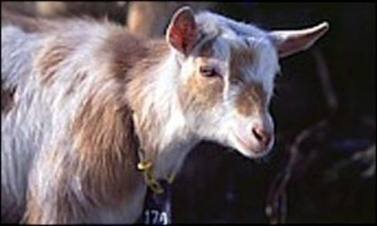
Spider Goat!
A goat that produces spider's web protein is about to revolutionize the materials industry. Stronger and more flexible than steel, spider silk offers a lightweight alternative to carbon fibre.
Up to now it has been impossible to produce "spider fibre" on a commercial scale. Unlike silk worms, spiders are too anti-social to farm successfully.
Now a Canadian company claims to be on the verge of producing unlimited quantities of spider silk - in goat's milk.
Using techniques similar to those used to produce Dolly the sheep, scientists at Nexia Biotechnologies in Quebec have bred goats with spider genes. (BBC)

Slide 20
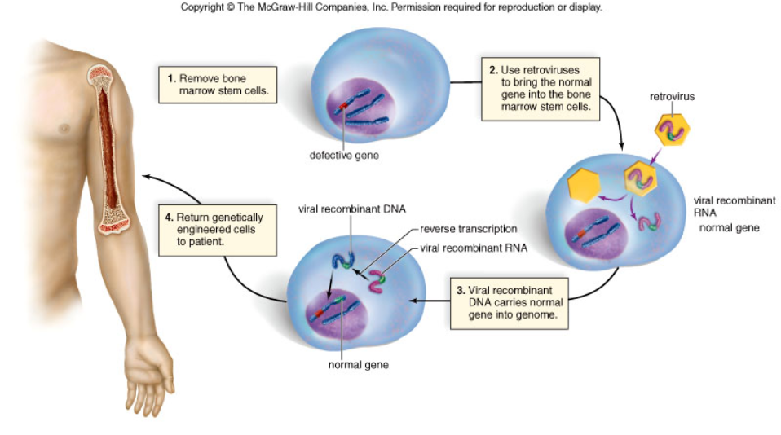
GENE THERAPY

Slide 21
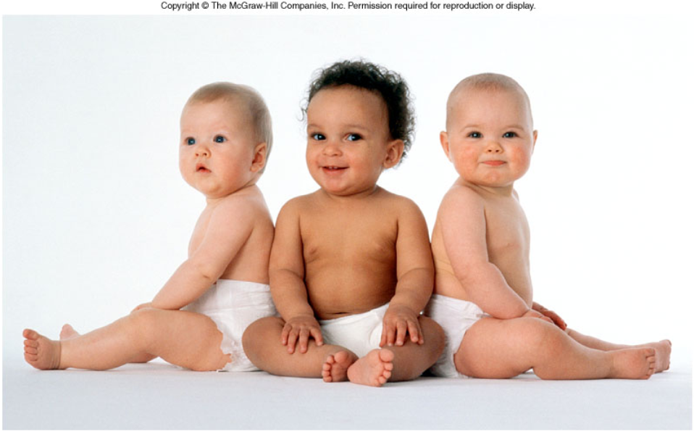
Can We Clone Humans?

Slide 22
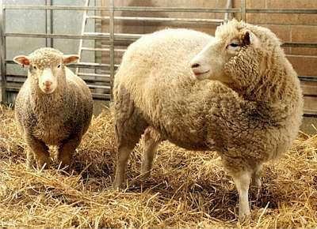
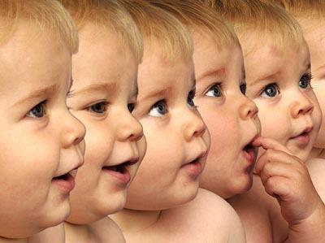
Dolly’s Clone → Human Clone?

Slide 23
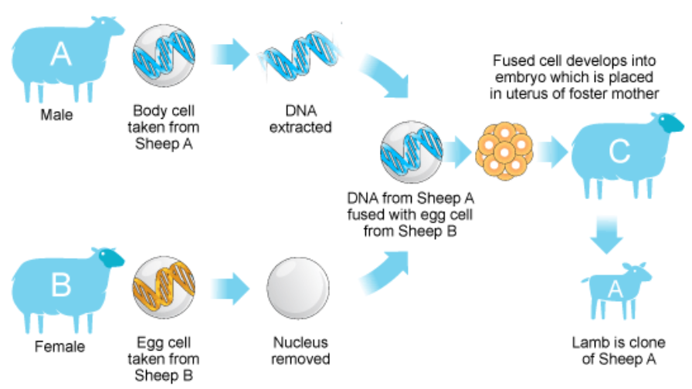
How to Clone a Sheep

Slide 24
