Slide 1
Section 2: Chemical Reactions
Chemical reactions allow living things to grow, develop, reproduce, and adapt.
K What I Know | W What I Want to Find Out | L What I Learned

Slide 2
Essential Questions
What are the parts of a chemical reaction?
How can energy changes be related to chemical reactions?
What is the importance of enzymes in living organisms?
Chemical Reactions
Copyright © McGraw-Hill Education

Slide 3
Vocabulary
Review
process
New
chemical reaction
reactant
product
activation energy
catalyst
enzyme
substrate
active site
Chemical Reactions
Copyright © McGraw-Hill Education

Slide 4
Reactants and Products
A chemical reaction is the process by which atoms or groups of atoms in substances are reorganized into different substances.
Chemical bonds are broken or formed during a chemical reaction.
Clues that a chemical reaction has taken place:
production of heat or light
formation of a new gas, liquid, or solid
Substances can also undergo physical changes, which change the appearance but not the composition.
Chemical Reactions
Copyright © McGraw-Hill Education

Slide 5
Reactants and Products
Chemical equations
In written chemical equations, chemical formulas describe the substances in the reaction and arrows indicate the process of change.
Reactants are the starting substances, on the left side of the arrow.
Products are the substances formed during the reaction, on the right side of the arrow.
The arrow can be read as “yields” or “react to form.”
Chemical Reactions
Copyright © McGraw-Hill Education

Slide 6
Reactants and Products
Chemical equations
Balanced equations
In chemical reactions, matter cannot be created or destroyed.
All chemical equations must show this balance of mass.
The number of atoms of each elements on the reactant side must equal the number of atoms of the same element on the product side.
C₆H₁₂O₆ + 6O₂ → 6CO₂ + 6H₂O
Chemical Reactions
Copyright © McGraw-Hill Education

Slide 7
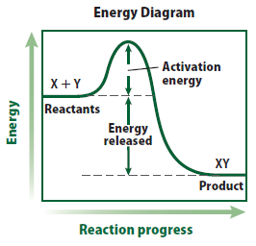
Energy of Reactions
Activation energy
The minimum amount of energy needed for reactants to form products is called activation energy.
Some reactions rarely happen due to the high activation energy required.
Chemical Reactions
Copyright © McGraw-Hill Education

Slide 8
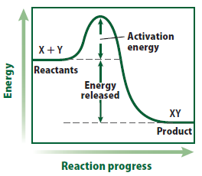
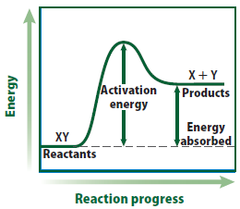
Energy of Reactions
Energy change in chemical reactions
Reactions that release energy in the form of heat are exothermic.
Reactions that absorb energy in the form of heat are endothermic.
Chemical Reactions
Copyright © McGraw-Hill Education

Slide 9
Enzymes
All living things are driven by chemical reactions.
Additional substances are needed to reduce activation energy and reaction time in living organisms.
A catalyst is a substance that lowers the activation energy needed to start a chemical reaction.
Catalysts do not change the amount of product produced, nor are they used up during the reaction.
Chemical Reactions
Copyright © McGraw-Hill Education

Slide 10
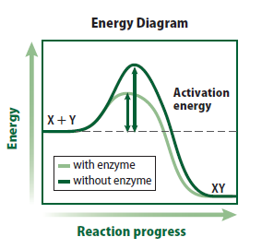
Enzymes
Special proteins called enzymes are the biological catalysts that speed up the rate of chemical reactions in biological processes.
Most enzymes are specific to one reaction.
Chemical Reactions
Copyright © McGraw-Hill Education

Slide 11
Enzyme-catalyzed reaction
Virtual Lab
FPO Add link to virtual lab from page 158 here.
Atoms, Elements, and Compounds
Copyright © McGraw-Hill Education

Slide 12
Does Temperature Affect an Enzyme Reaction?
Video Lab
FPO Add link to video lab from page 158 here.
Atoms, Elements, and Compounds
Copyright © McGraw-Hill Education

Slide 13
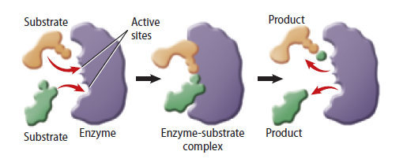
Enzymes
The reactants that bind to an enzyme are called substrates.
The specific location where a substrate binds on an enzyme is called the active site.
Factors such as pH, temperature, and other substances affect enzyme activity.
Chemical Reactions
Copyright © McGraw-Hill Education

Slide 14
Review
Essential Questions
What are the parts of a chemical reaction?
How can energy changes be related to chemical reactions?
What is the importance of enzymes in living organisms?
Vocabulary
chemical reaction
reactant
product
activation energy
catalyst
enzyme
substrate
active site
Chemical Reactions
Copyright © McGraw-Hill Education

