Slide 1
Section 3: Water and Solutions
The properties of water make it well suited to help maintain homeostasis in an organism.
K What I Know | W What I Want to Find Out | L What I Learned

Slide 2
Essential Questions
How does the structure of water make it a good solvent?
What are the similarities and differences between solutions and suspensions?
What are the differences between acids and bases?
Water and Solutions
Copyright © McGraw-Hill Education

Slide 3
Vocabulary
Review
physical property
New
polar molecule
hydrogen bond
mixture
solution
solvent
solute
acid
base
pH
buffer
Water and Solutions
Copyright © McGraw-Hill Education

Slide 4
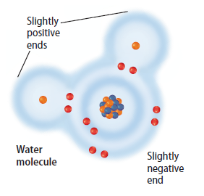
Water’s Polarity
Water molecules are formed by covalent bonds that link two hydrogen (H) atoms to one oxygen (O) atom.
Water molecules have a slightly positive end near the H atoms and a slightly negative end near the O atom.
Molecules that have an uneven distribution of charge are called polar molecules, meaning they have oppositely charged regions.
Water and Solutions
Copyright © McGraw-Hill Education

Slide 5
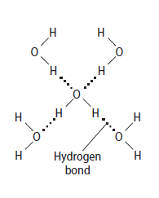
Water’s Polarity
When a charged region of a polar molecule comes close to the oppositely charged region of another polar molecule, a weak attraction forms.
A hydrogen bond is a weak interaction involving a hydrogen atom and a fluorine, oxygen, or nitrogen atom.
A hydrogen bond is a strong type of van der Waals force.
Water and Solutions
Copyright © McGraw-Hill Education

Slide 6
Visualizing Properties of Water
Animation
FPO Add link to animation from page 162 (Figure 20) here.
Water and Solutions
Copyright © McGraw-Hill Education

Slide 7
Mixtures with Water
A mixture is a combination of two or more substances in which each substance retains its individual characteristics and properties.
Mixtures are either homogeneous or heterogeneous.
Water and Solutions
Copyright © McGraw-Hill Education

Slide 8
Mixtures with Water
Homogeneous mixtures
When a mixture has a uniform composition throughout, it is called homogenous.
A solution is another name for a homogeneous mixture.
In a solution, there are two components:
A solvent is a substance in which another substance is dissolved.
A solute is the substance that is dissolved in the solvent.
Water and Solutions
Copyright © McGraw-Hill Education

Slide 9
Mixtures with Water
Heterogeneous mixtures
When the components in a mixture remain distinct, it is a heterogeneous mixture.
A suspension is a type of heterogeneous mixture where the particles settle out over time
A colloid is a heterogeneous mixture in which the particles do not settle out.
Water and Solutions
Copyright © McGraw-Hill Education

Slide 10
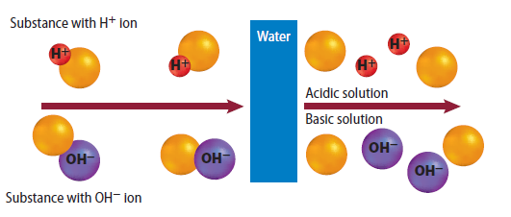
Mixtures with Water
Acids and bases
Many solutes readily dissolve in water because of water’s polarity.
Substances that release H⁺ when they are dissolved in water are called acids.
Substances that release hydroxide ions (OH⁻) when they are dissolved in water are called bases.
Water and Solutions
Copyright © McGraw-Hill Education

Slide 11
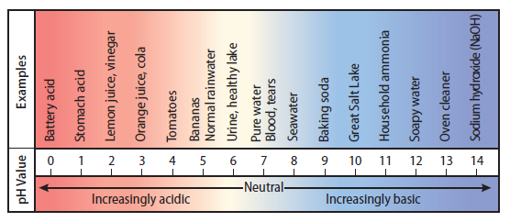
Mixtures with Water
pH and buffers
The amount of hydrogen or hydroxide ions in a solution determines the strength of an acid or base.
The measure of concentration of H⁺ in a solution is called pH.
Acids have pH values < 7; bases have pH values > 7
Buffers are mixtures that can react with acids or bases to keep the pH within a particular range.
Water and Solutions
Copyright © McGraw-Hill Education

Slide 12
Review
Essential Questions
How does the structure of water make it a good solvent?
What are the similarities and differences between solutions and suspensions?
What are the differences between acids and bases?
Vocabulary
polar molecule
hydrogen bond
mixture
solution
solvent
solute
acid
base
pH
buffer
Water and Solutions
Copyright © McGraw-Hill Education

