Slide 1
Electrical Current & Circuits

Slide 2
Indicators and Objectives
PS-6.6: Explain the relationships among voltage, resistance, and current in Ohm’s law.
PS-6.9: Compare the functioning of simple series and parallel circuits.
Explain the relationship between voltage, resistance and current in an electrical circuit—including units for each
Predict energy transformations in a circuit using voltage, resistance, and current
Compare/contrast series and parallel circuits in terms of structure, function, and changes in each.

Slide 3
Section 7.2: Electric Current
Static Electricity: build up of charges that pass QUICKLY to another object
Electric Current: continuous flow of charges through a conductor

Slide 4
Static Electricity
Objects can acquire a static electric charge through:
Friction (when an object whose electrons are loosely held rubs against another object)
Conduction (when an object with an excess of electrons touches a neutral object)
Induction (a neutral object acquires a charge from a charged object close by without contact being made)

Slide 5
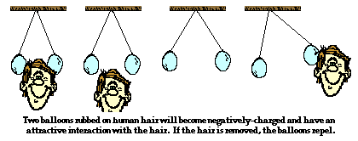
Friction

Slide 6
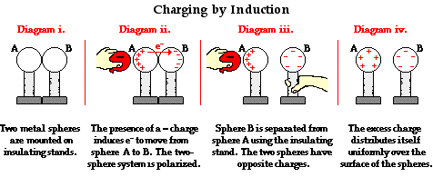
Induction

Slide 7
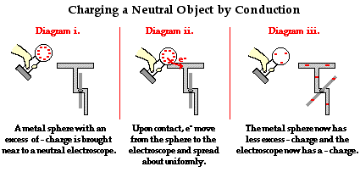
Conduction
Charging by contact!

Slide 8
Electricity and Voltage
- Electricity is the flow of electrons (-)
Charges (-) flow from HIGH voltage areas to LOW voltage areas
Voltage is like electrical pressure that pushes and pulls charges
Voltage Difference: the push/pull that causes charges to move and is measured in volts (V)

Slide 9
Voltage
Voltage is created by
a chemical cell (battery) when it changes chemical energy to electrical energy
by a generator when it changes mechanical energy to electrical energy
by a solar cell when it changes light energy to electrical energy.

Slide 10
Voltage and Current
When a wire connects the terminals of a battery or generators, then the voltage will push and pull electrons through a conductor.
One terminal has extra electrons thus a negative charge. The other terminal has a deficit of electrons and thus a positive charge.
Electrons in the wire are pushed by the negative terminal and pulled by the positive terminal through the wire
Circuit: a closed, conducting path
For changes to flow, the wire must always be connected in a circuit
Electric Current: the flow of charges through a wire or any conductor.
Measured in Amperes (A=Amps)
Current is almost always the flow of electrons
What happens if we break the circuit?

Slide 11
Check for Understanding
What is voltage?
How is voltage generated? (3 ways)
What is current?

Slide 12
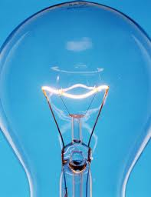
Resistance
Resistance: the tendency for a material to oppose the flow of electrons
Changes electrical energy into thermal energy and light
Ex: lightbulb filament
Resistance is measured in Ohms (Ω)

Slide 13
What Affects Resistance?

Slide 14
IV. Control the Flow
A voltage difference causes the charges to flow
Flow of charges= current (Amps or A)
Electrical resistance restricts the movement of charges
Resistance = current
Pressure = current
(Voltage Difference)

Slide 15
Ohm’s Law
Current = voltage difference
Resistance
I = V/R or V=IR
I= current (units = A, amps)
V= voltage (units = V, volts)
R = resistance (units = ohms Ω)
Tutorial

Slide 16
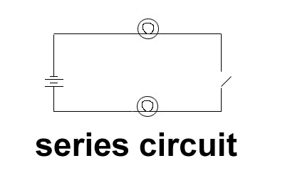
Section 3 – Electrical Energy
I. Series Circuit: the current has only one loop to
flow through
things are wired one right after the other
If one thing (bulb) goes out every thing goes out
If the circuit is broken the entire flow of current stops

Slide 17
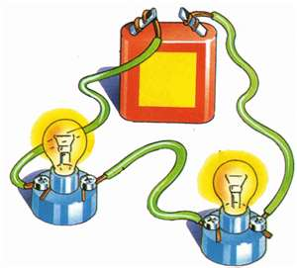
Series Circuit
Current is the same at each point in the circuit
When another resistor (light bulb) is added in series, the total resistance increases.
When resistance increases, current will decrease.
Decreased current means dimmer light.

Slide 18
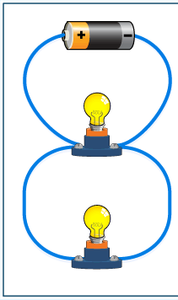
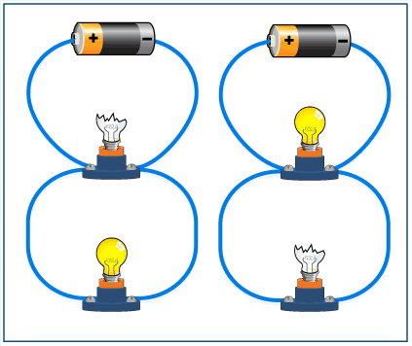
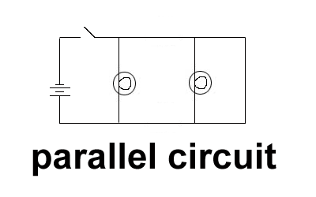
II. Parallel Circuit: contains two or more branches for current to move through
current splits up to flow through the different branches
because all branches connect the same two points of the circuit – the voltage difference is the same in each branch
more current flows through the branches that have the lower resistance

Slide 19
Household Electrical Safety
In a house, many appliances draw current from the same circuit
If more appliances are connected to a circuit, more current will flow through the wires
More current in wires = more heating in the wires
More heat causes insulation on wires to melt, which increases chances of fire
To protect a house from this, all household circuits have a:
Fuse, or
Circuit breaker

Slide 20
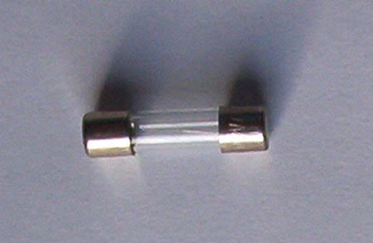
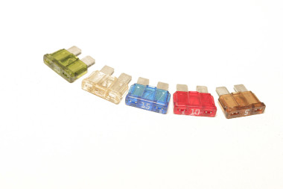
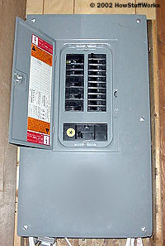
Household Circuits:
Fuse: a small piece of metal that melts if the current becomes too high
Circuit Breaker: contains a small piece of metal that bends when it gets hot bending causes a switch to flip and opens the circuit

Slide 21
Let’s Compare Series and Parallel Circuits
Series Circuits
Parallel Circuits
_______ path(s) for current
Current ________________
Voltage ________________
Break in circuit _______________________
Adding resistance in series ______________________
_______ path(s) for current
Current ________________
Voltage ________________
Break in circuit _______________________
Adding resistance in parallel _______________________

Slide 22
Let’s Compare Series and Parallel Circuits
Series Circuits
Parallel Circuits
1 path(s) for current
Current is the same at every point
Voltage drops at each resistor
Break in circuit stops all current
Adding resistance in series decreases total current (dimmer light bulbs)
multiple path(s) for current
Current can be different in each branch
Voltage same across each resistance
Break in circuit does not affect other bulbs
Adding resistance in parallel increases total current

