Slide 1
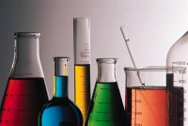
Lab Equipment

Slide 2
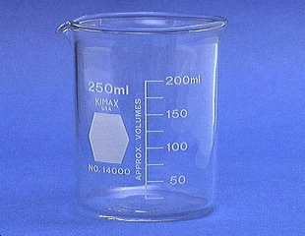
Beaker
Beakers hold solids or liquids that will not release gases when reacted or are unlikely to splatter if stirred or heated.

Slide 3
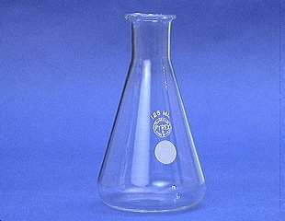
Erlenmeyer Flask
Erlenmeyer flasks hold solids or liquids that may release gases during a reaction or that are likely to splatter if stirred or heated.

Slide 4
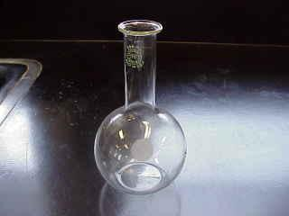
Florence Flask
Rarely used in first year chemistry, it is used for the mixing of chemicals. Narrow neck prevents splash exposure.

Slide 5
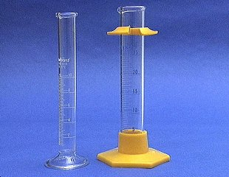
Graduated Cylinder
A graduated cylinder is used to measure volumes of liquids.

Slide 6
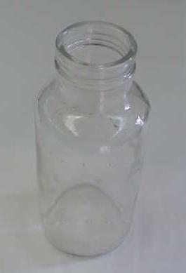
Gas Collecting Bottle
We use gas collecting bottles when large volumes of gases are produced, and must be collected by the displacement of water.

Slide 7
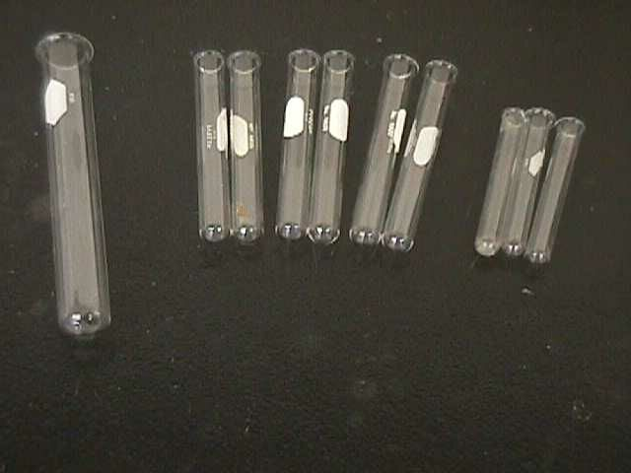
Test Tubes
13 x 100 mm test tubes
Ignition
tube
10 x 75 mm test tubes

Slide 8
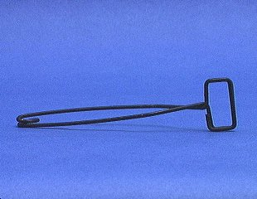
Test Tube Holder
A test tube holder is useful for holding a test tube which is too hot to handle.

Slide 9
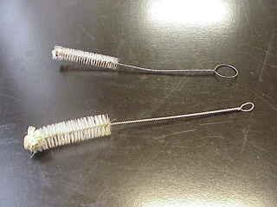
Test Tube Brushes
Test tube brushes are used to clean test tubes and graduated cylinders.
Forcing a large brush into a small test tube will often break the tube.

Slide 10
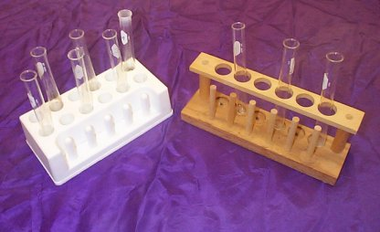
Test Tube Racks
Test tube racks are for holding and organizing test tubes on the laboratory counter. Plastic racks may melt in contact with very hot test tubes.

Slide 11
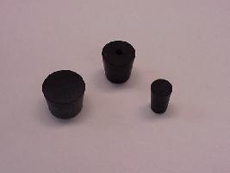
Rubber Stoppers
Rubber stoppers are used to close containers to avoid spillage or contamination.
Containers should never be heated when there is a stopper in place.

Slide 12
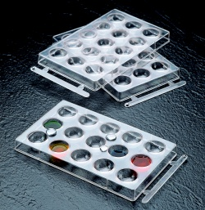
Spot Plates
Spot plates are used when we want to perform many small scale reactions at one time. We will use these many times during the year.

Slide 13
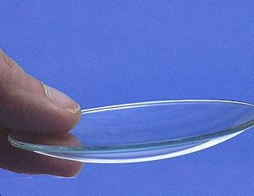
Watch Glass
A watch glass is used to hold a small amount of solid, such as the product of a reaction.

Slide 14
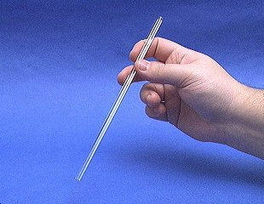
Glass Stir Rod
A glass rod is used to manually stir solutions. It can also be used to transfer a single drop of a solution.

Slide 15
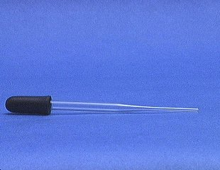
Medicine Dropper
A medicine dropper is used to transfer a small volume of liquid (less than one mL).
On top of each medicine dropper is a “rubber bulb”

Slide 16
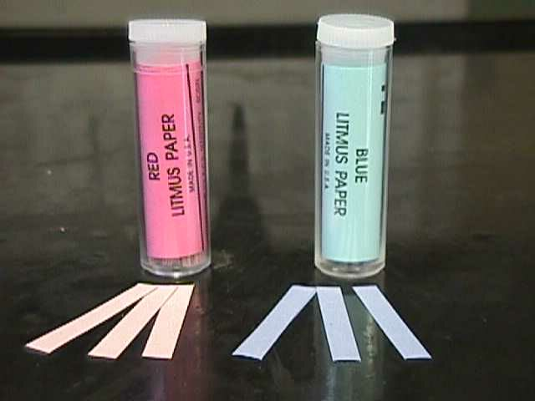
Litmus Paper
Red litmus paper is used to identify bases.
Blue litmus paper is used to identify acids.

Slide 17
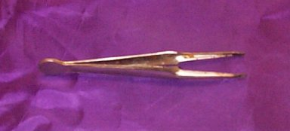
Forceps
Forceps (or tweezers) are used to pick up small objects.

Slide 18
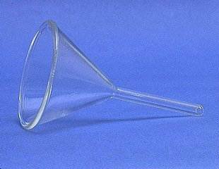
Funnel
A funnel is used to aid in the transfer of liquid from one vessel to another.

Slide 19
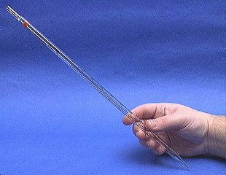
Mohr Pipet
A Mohr pipet measures and delivers exact volumes of liquids.

Slide 20
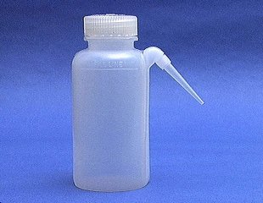
Wash Bottle
A wash bottle has a spout that delivers a wash solution to a specific area. Distilled water is the only liquid that should be used in a wash bottle.

Slide 21
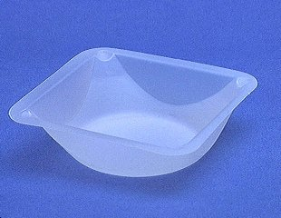
Weighing Boat
Weighing boats are used to weigh solids that will be transferred to another vessel.

Slide 22
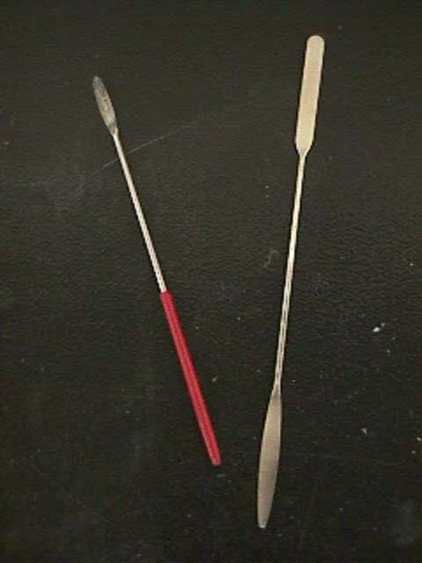
Spatulas
Spatulas are used to dispense solid chemicals from their containers.
Chemicals should never be transferred with your bare hands.

Slide 23
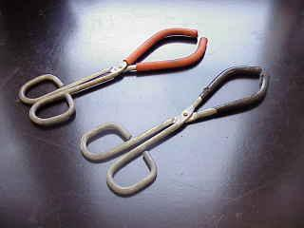
Beaker Tongs
Beaker tongs are used to move beakers containing hot liquids

Slide 24
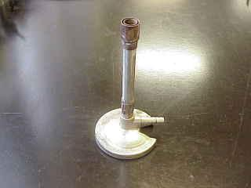
Bunsen Burner
Bunsen burners are used for the heating of nonvolatile liquids and solids.

Slide 25
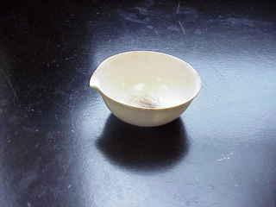
Evaporating Dish
The evaporating dish is used for the heating of stable solid compounds and elements.

Slide 26
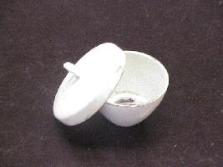
Crucible
Crucibles are used for heating certain solids, particularly metals, to very high temperatures.

Slide 27
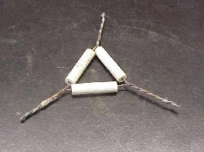
Clay Triangle
The clay triangle is used as a support for porcelein crucibles when being heated over a Bunsen burner.

Slide 28
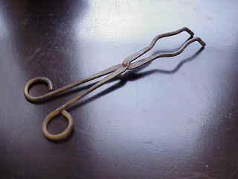
Crucible Tongs
For handling hot crucibles; also used to pick up other hot objects. NOT to be used for picking up beakers!

Slide 29
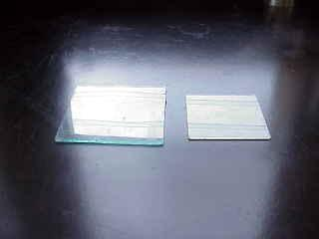
Glass Plates
Glass plates provide a surface for semi-micro scale experiments, such as drop reactions and testing of acids and bases.

Slide 30
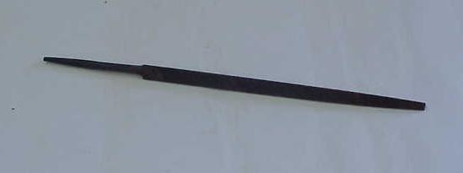
Triangular File
Triangular files are used primarily to cut glass rod, a skill that your instructor will share with you when it becomes useful.

Slide 31
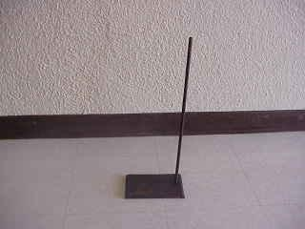
Ringstands and their Components
Ringstands are a safe and convenient way to perform reactions that require heating using a Bunsen burner.

Slide 32
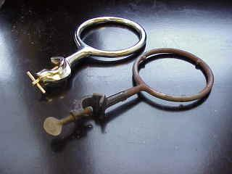
Ringstands and their Components Iron Rings
Iron rings connect to a ringstand and provide a stable, elevated platform for the reaction.

Slide 33
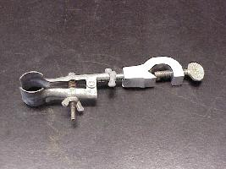
Ringstands and their Components Utility Clamps
Utility clamps are used to secure test tubes, distillation columns, and burets to the ringstand.

Slide 34
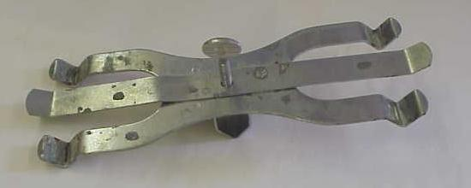
Ringstands and their Components Double Buret Clamps
Double Buret clamps are used to burets – long graduated tubes used in titration.

Slide 35
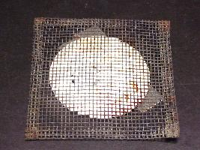
Ringstands and their Components Wire Gauze
Wire gauze sits on the iron ring to provide a place to stand a beaker.
On older wire gauze, the white material is asbestos!

Slide 36
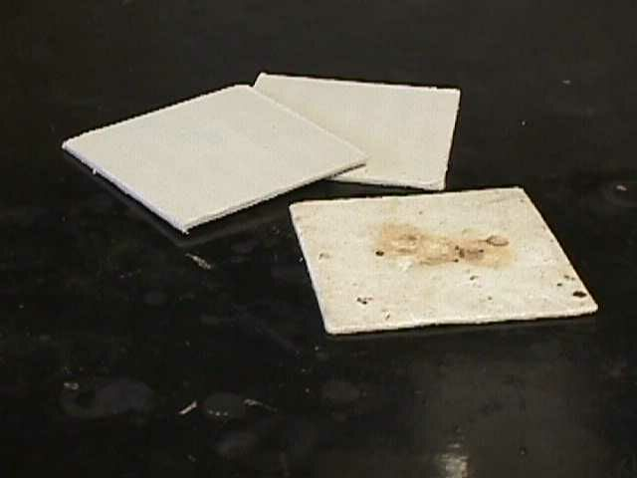
Pressed Fiber Pad
A 4” x 4” square of ceramic fiber, it provides a surface for hot beakers so that the beaker does not come in contact with a cold countertop and shatter.

Slide 37
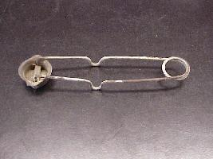
Strikers
Strikers are used to light Bunsen burners.
The flints on strikers are expensive. Do not operate the striker repeatedly just to see the sparks!

