Slide 1
Plant Adaptations

Slide 2
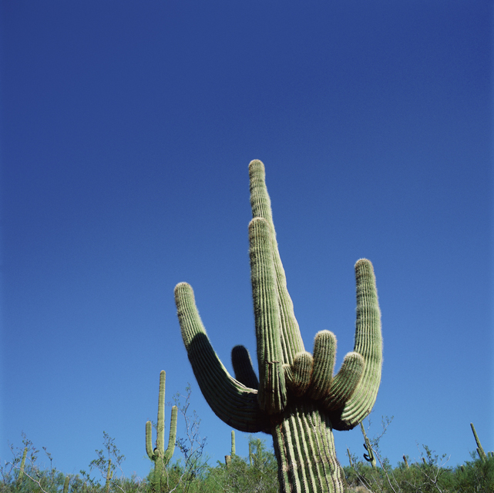
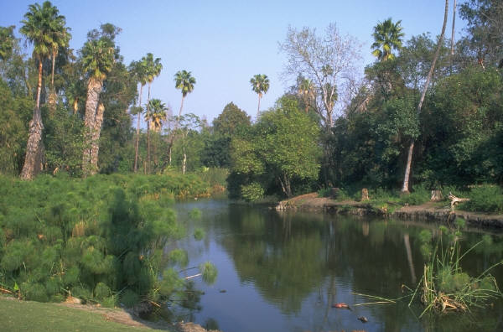
An adaptation is a characteristic which helps an organism to survive in its environment.
Adaptations are specific to an particular environment. For example, a cactus would not survive for very long in a swamp.

Slide 3
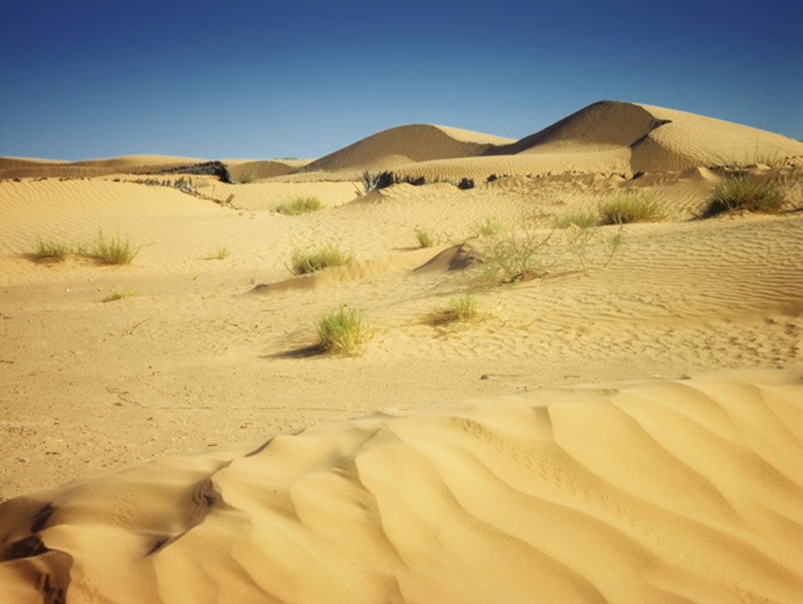
Deserts
Deserts are dry and often hot. Some characteristics of deserts include-
Annual rainfall less than 10 inches, usually occurring during a rainy season
Soil is poor- sandy or rocky
Intense direct sunlight

Slide 4
Desert Plant Adaptations
Succulents- store water in their leaves
Small or no leaves present reduces water loss due to transpiration
Long, deep root structure
Short life cycle coincides with rainy season
Waxy coating on leaves reduces water loss
Spines, which are modified leaves, discourage animals from eating the plants for water

Slide 5
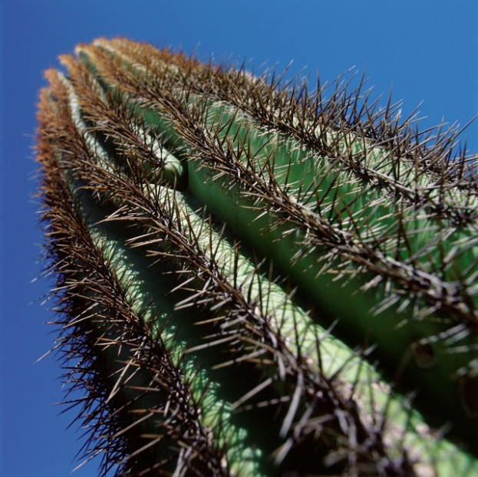
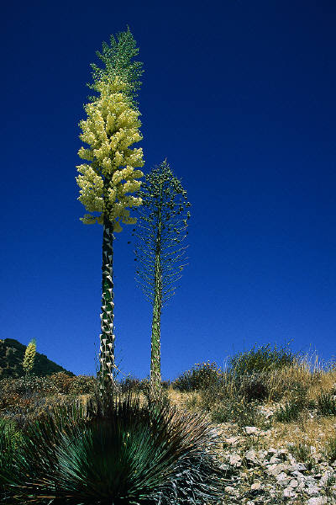
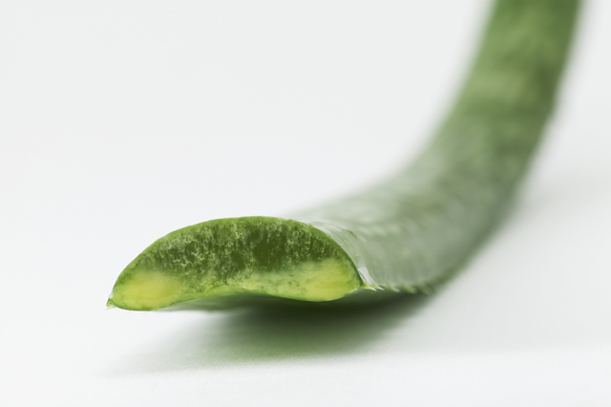
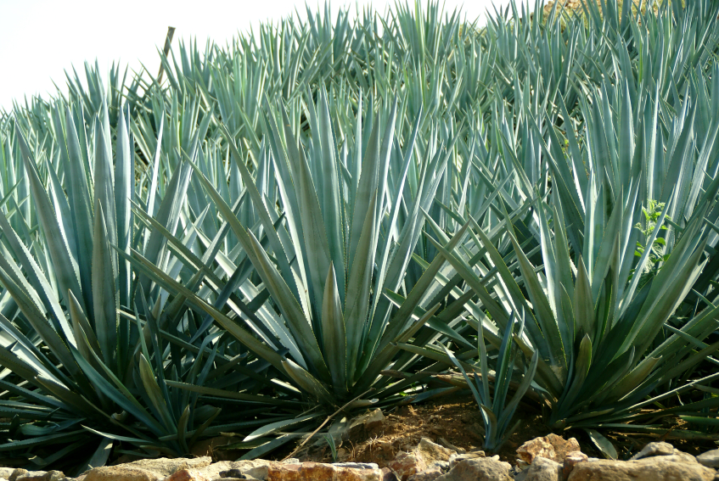
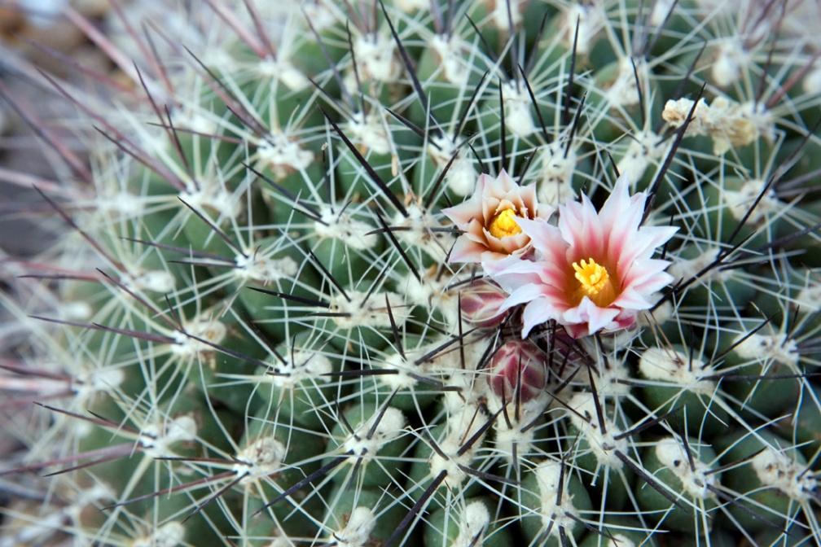
Desert Plants

Slide 6
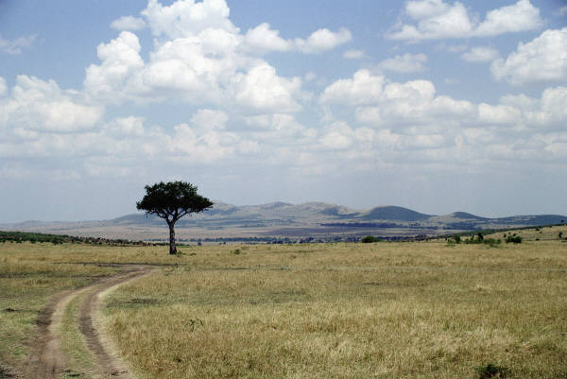
Temperate Grasslands (Prairie)
Hot summers, cold winters
Rainfall can be sporadic, drought is common
Annual rainfall between 10-30 inches/year
Few trees
Regular fires
Soil is rich in organic material
Soil is well suited for agriculture

Slide 7
Grassland Plant Adaptations
Due to regular fires, above ground plant burns but roots survive and re-sprout a new plant
Trees have thick, fire resistant bark
Extensive root systems absorb as much moisture as possible.
Grasses have narrow leaves to prevent water loss
Wind pollinated to take advantage of windy conditions

Slide 8
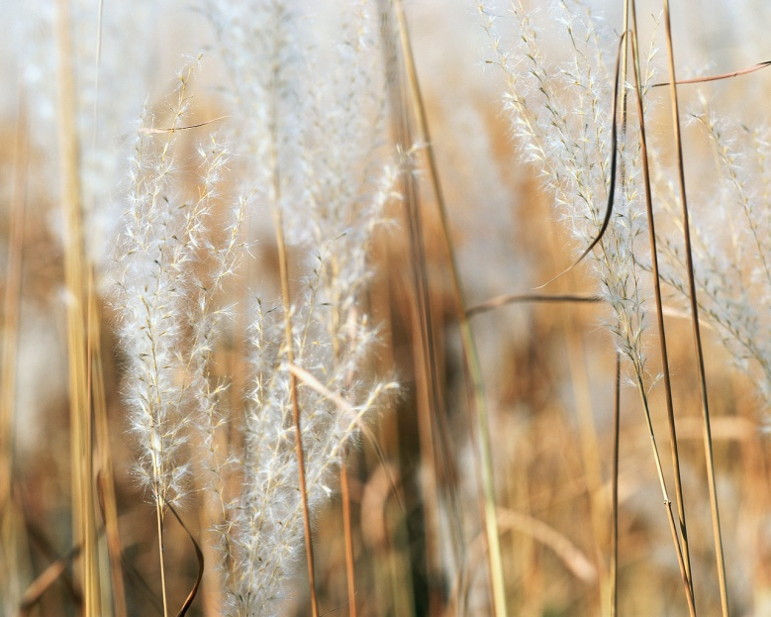
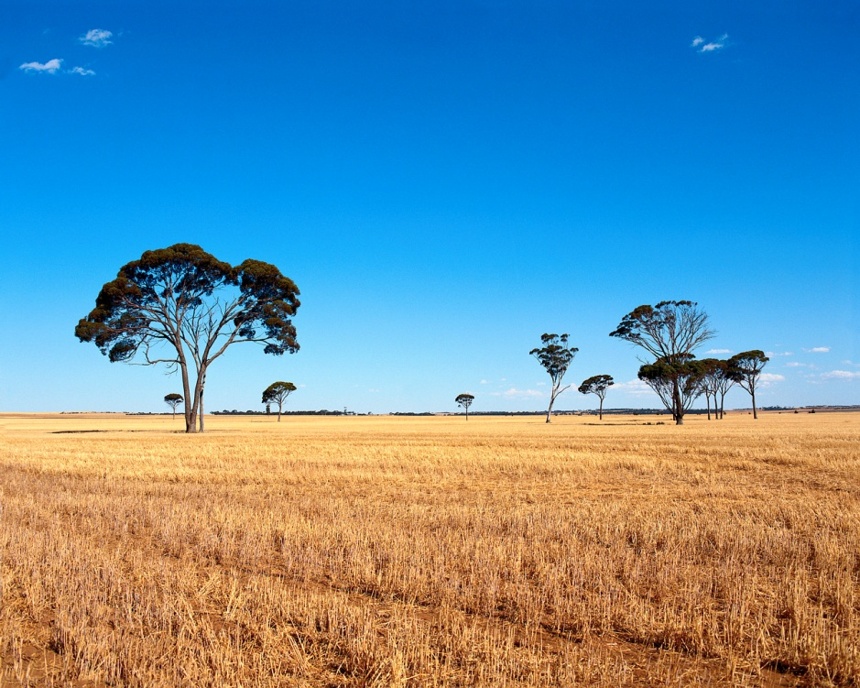
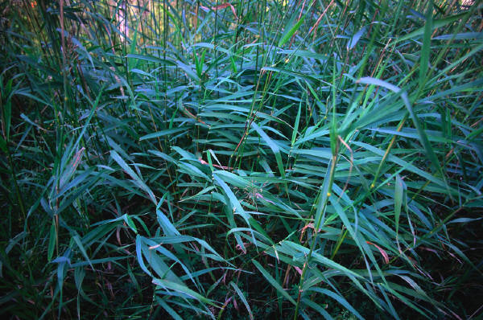
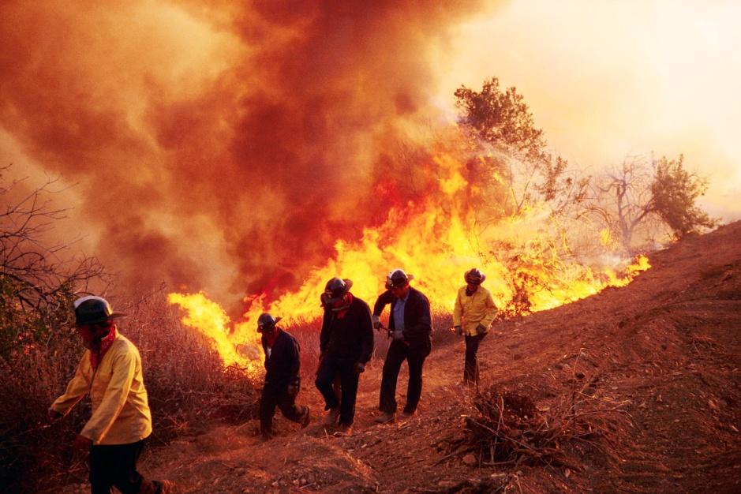
Grassland Plants

Slide 9
Tropical Rainforests
Hot, humid with rainfall between 80-180 inches annually.
Poor soil due to leaching
Plants grow quickly to use up any available organic material
Little sunlight at forest floor
Intense sunlight in the canopy layer

Slide 10
Tropical Rainforest Plant Adaptations
Drip tips and waxy layer allow water to run off leaves
Buttress and prop roots hold up plants in shallow soil
Plants climb or live on others to reach sunlight
Epiphytes, or “air” plants, have aerial roots that cling to a host plant
Flowers lure animal pollinators due to lack of wind pollination on forest floor

Slide 11
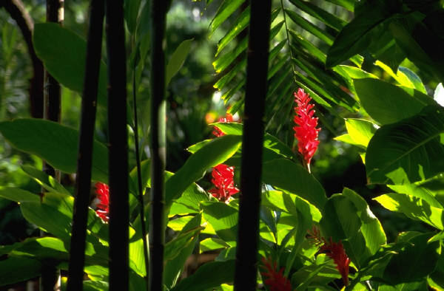
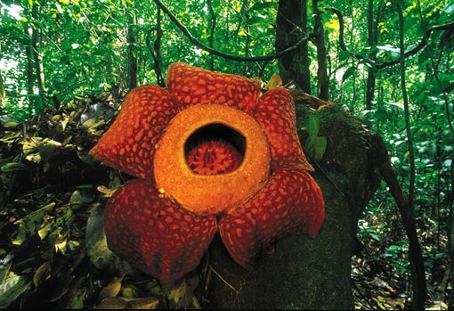
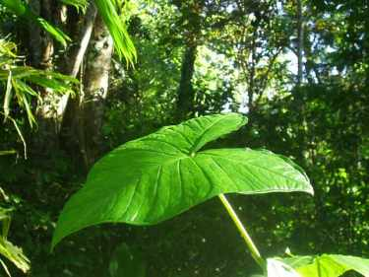
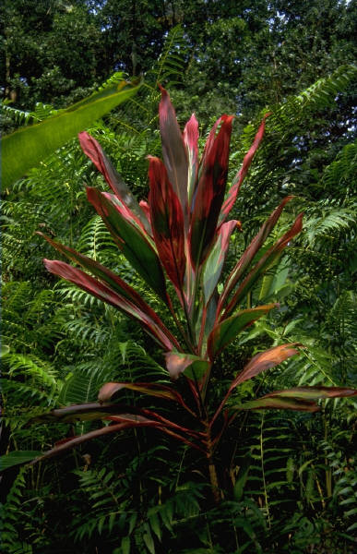
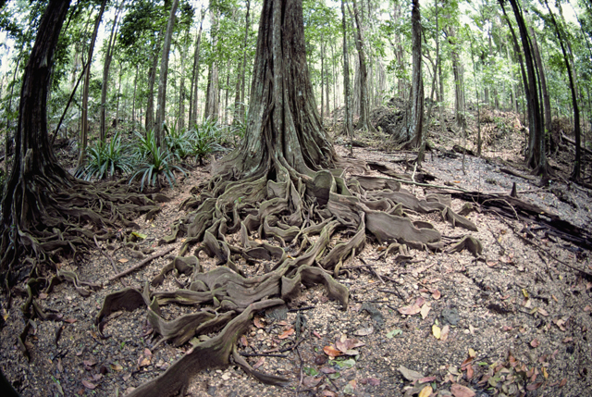
Tropical Plants

Slide 12
Temperate Deciduous Forest
Has four distinct seasons: spring, summer, autumn, winter
Average annual rainfall 30-50 inches
Rich soil
Forest made up of distinct layers: herb layer, shrub layer, understory and canopy

Slide 13
Temperate Deciduous Plant Adaptations
Wildflowers grow in early spring before the trees leaf out and shade the forest floor
Trees have thick bark to protect against cold winters
Drop leaves in autumn, re-grow new leaves in spring
Deciduous leaves are thin and broad to capture as much light as possible during the warmer months

Slide 14
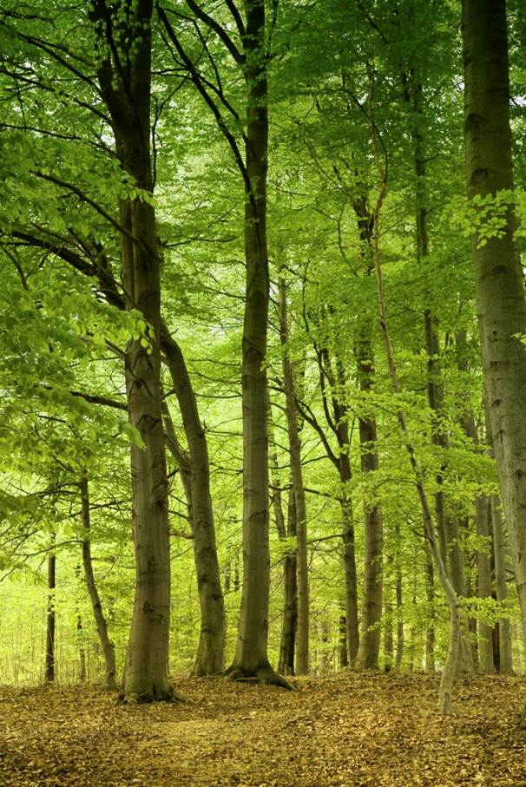
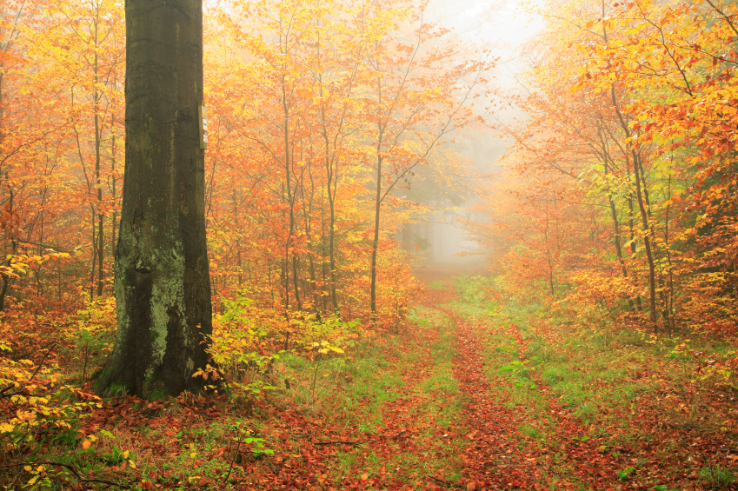
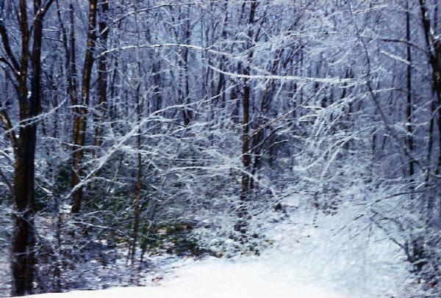
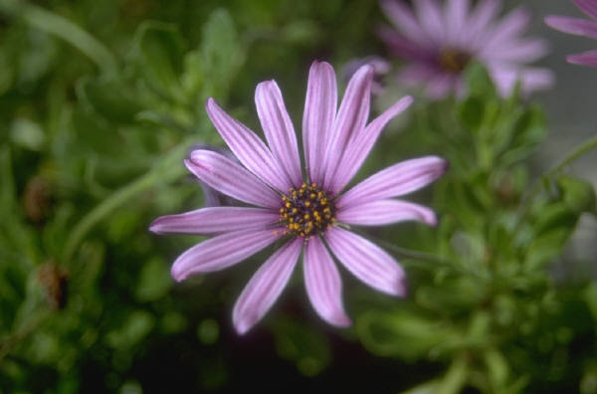
Temperate Deciduous Forest Plants

Slide 15
Taiga (Boreal Forest)
Dominated by conifers (evergreens)
Cold winters and warm summers
Some areas have a layer of permanently frozen ground called permafrost
Poor drainage due to permafrost and layers of rock just below the soil
Annual rainfall of approx, 20 inches
Many lakes, bogs and swamps

Slide 16
Taiga Plant Adaptations
Evergreen trees retain leaves (needles) year round so they can begin photosynthesizing as soon as it is warm enough
Needles prevent water loss and shed heavy snow more easily
Needles are dark in color to absorb more solar energy
Downward drooping branches shed snow easily

Slide 17
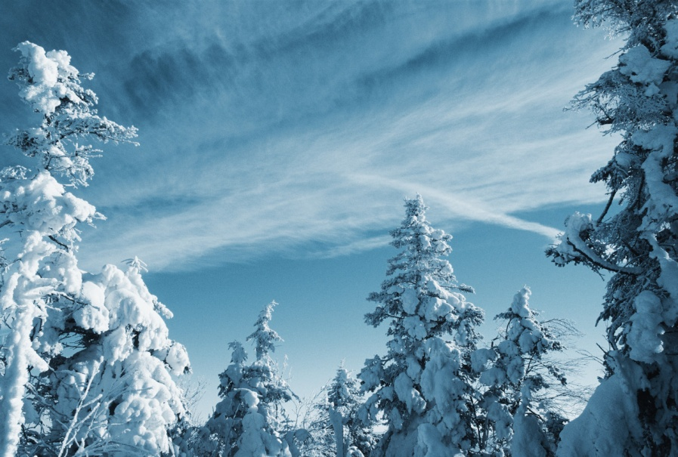
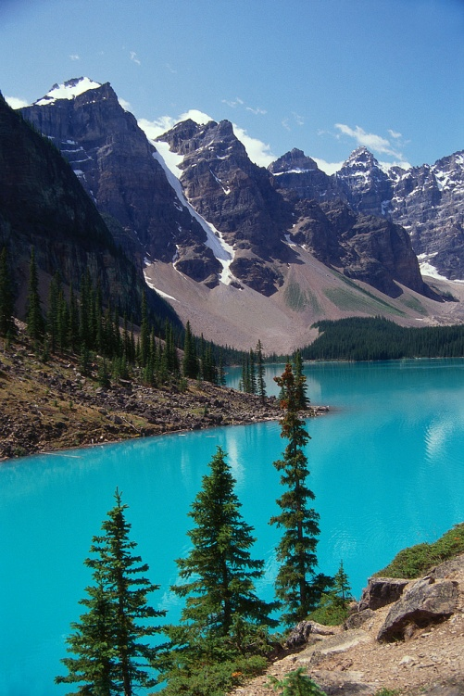
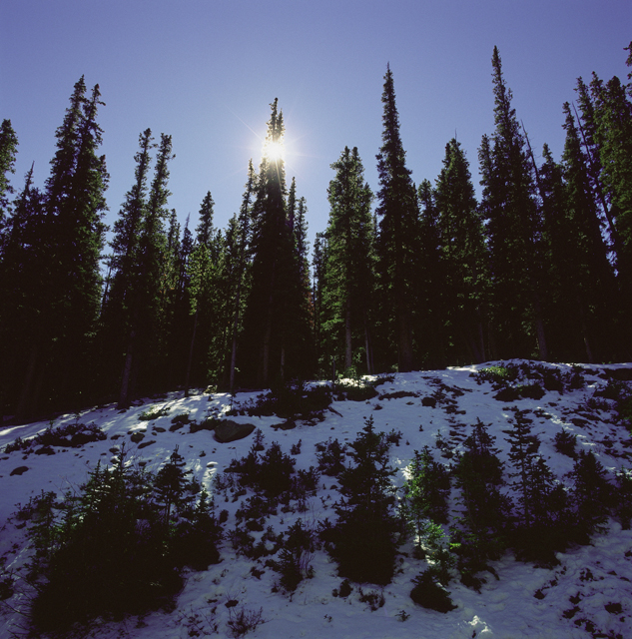
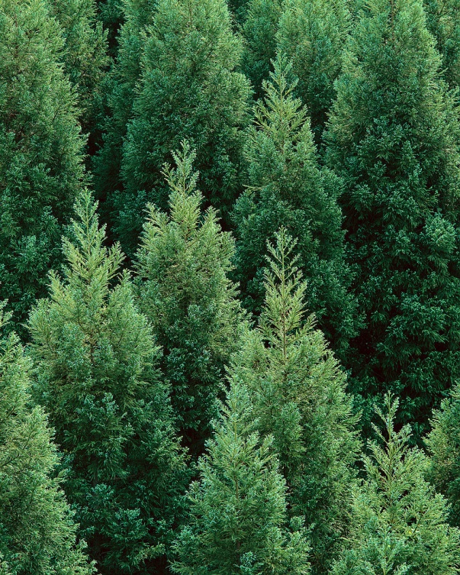
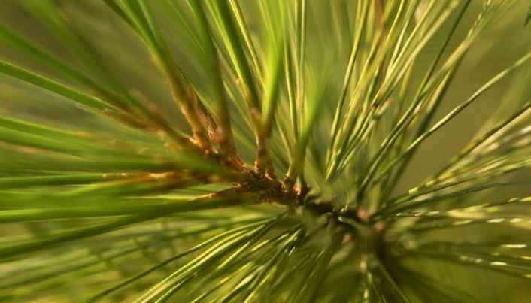
Taiga Plants

Slide 18
Tundra
Short, cool summers and long, cold winters
Has a permanently frozen layer called permafrost
Poor drainage due to permafrost and cold temperatures
Annual precipitation low at only 4-10 inches, usually as snow or ice
Growing season has 24 hours of sunlight/day, long nights in winter
Little diversity

Slide 19
Tundra Plant Adaptations
Usually small and low growing, helps keep plant from freezing
Dark colored plants help absorb the sun’s rays
Some plants grow in clumps for protection from wind and cold
Some plants have dish-like flowers which follow the sun to absorb more solar energy

Slide 20
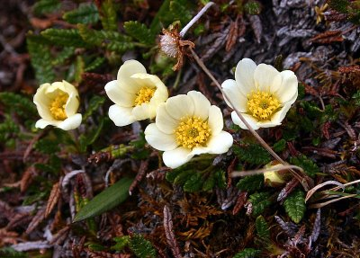
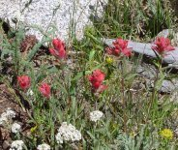


Tundra Plants

Slide 21
Plants Adapted to Water
Flexible underwater leaves and stems to move with the current
Some plants have air in stems to hold plant upright
Lack strong water transport system, instead absorb water/nutrients directly through the leaves
Floating leaves gather sunlight
Some plants produce floating seeds

Slide 22

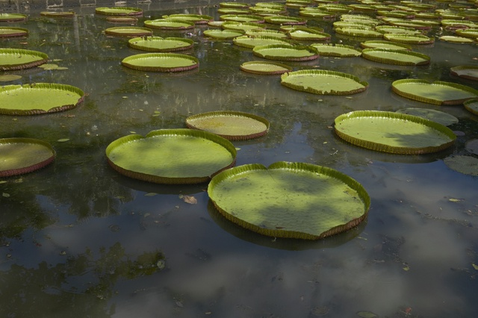
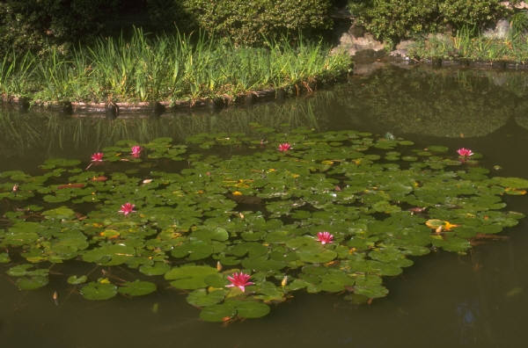
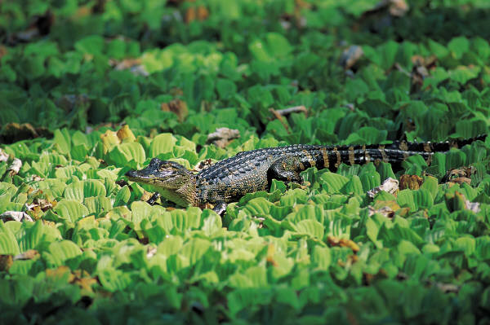
Plants Adapted to Water

