Slide 1
Internet Sources
http://salamander.uky.edu/srvoss/schedule06.htm
http://www.becominghuman.org/
TREE OF LIFE PROJECT: http://tolweb.org/
http://en.wikipedia.org/wiki/Theria
http://en.wikipedia.org/wiki/Australopithecus
http://jp.reuters.com/news/articlenews.aspx?type=scienceNews&storyID=2007-04-20T202309Z_01_N20329580_RTRUKOC_0_US-CHIMPANZEES-GENES.xml&WTmodLoc=Home-C5-scienceNews-3

Slide 2
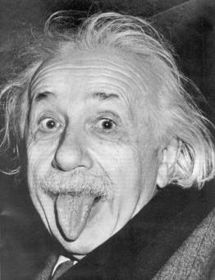
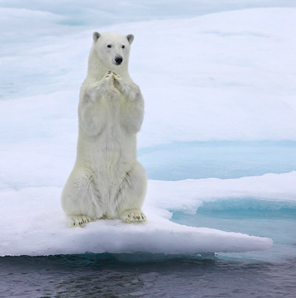
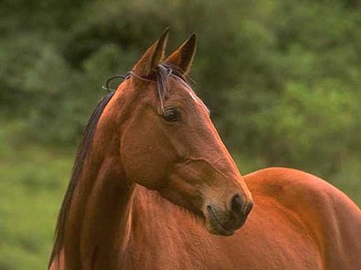
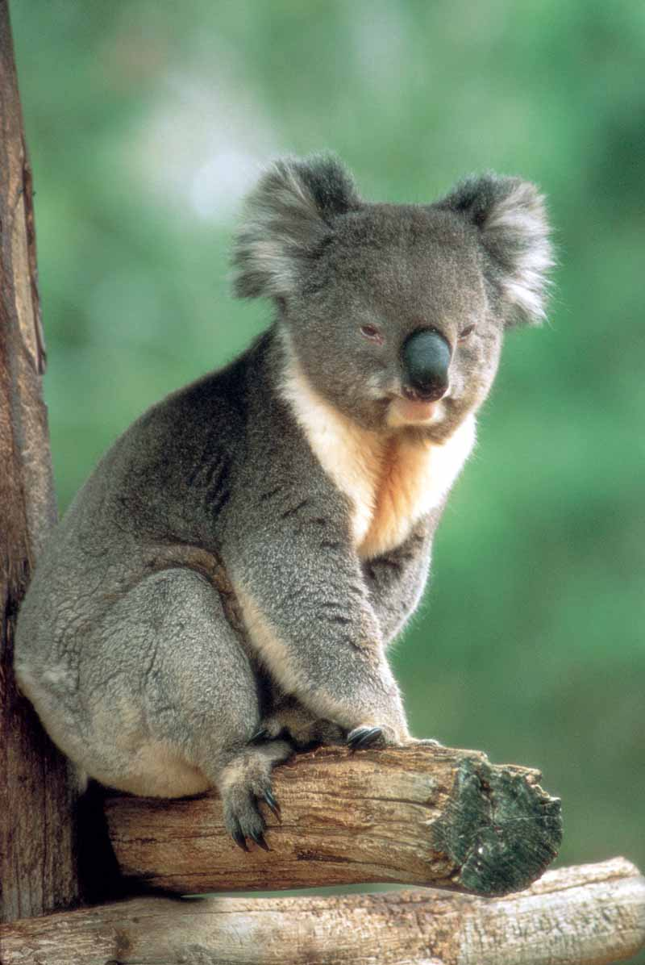
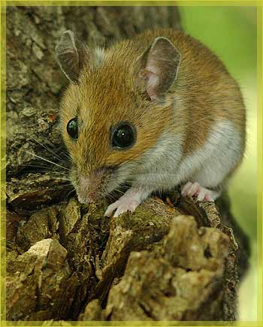
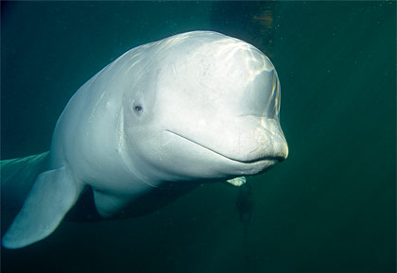
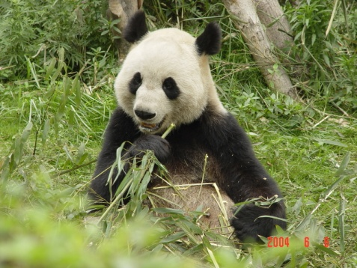
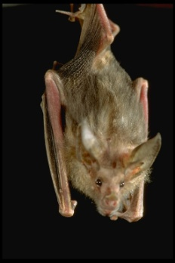
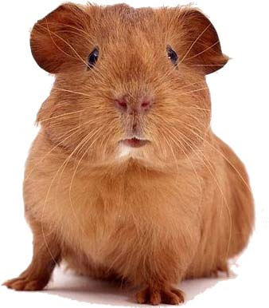
Mammals
Mammals- share characteristics with other mammals such as: vertebrate with a spinal chord, skeleton, skull housing a large brain, ability to give birth to live offspring, mammary glands, hair or fur, and common ancestry.

Slide 3
Phylogeny for the Class Mammalia - Infraclasses
Mammals- share characteristics with other mammals such as: vertebrate with a spinal chord, skeleton, skull housing a large brain, ability to give birth to live offspring, mammary glands, hair or fur, and common ancestry.

Slide 4
Phylogeny for Placental Mammals - Orders

Slide 5
Phylogeny for Primates – Parvorders and Families

Slide 6
Similarities and Differences Between Humans and Other Mammals
Teeth
canines - for tearing and piercing (most carnivores)
incisors - nip and cut food (rodents)
premolars with cusps - grinding and crushing (horses)
molars with cusps - grinding and crushing (cattle)
Early and more primitive mammals have 66 teeth; modern mammals have 44; humans have 32.
The incidence of Wisdom teeth appear to be diminishing (natural selection?) in human populations (in Central Europe, one or more wisdom teeth are missing in 19% of population. Wisdom teeth or third molars are common among Native Americans, but not among Africans).
Offspring have an extended period of learning.
Humans have an overall larger brain size.
Humans possess behavioral flexibility

Slide 7
TRENDS IN PRIMATE EVOLUTION
Change in overall skeletal structure and mode of locomotion - bipedalism (able to move on 2 appendages for extended periods of time; with minimum energy loss).
Modification of hands - humans can cup hands and possess a opposable thumb.
Less reliance on sense of smell and more reliance on sense of daytime and color vision, and depth perception.
Change in dentition - primates moved from eating insects to more fruits and vegetables to becoming omnivorous - adaptation of teeth is probably caused by natural selection, so that the kinds of teeth best able to accommodate a particular diet become enhanced over time.
Brain expansion - more elaborate.
Gorilla 600 cm³
Humans 1350 cm³
Higher intelligence may have resulted from tool making, need for better memory, or to increase ability to anticipate jumps (from branch to branch) or throws (weapons and spears). Once you let go of something, you don't have any way to control its motion.
Behavioral and cultural evolution- ability to learn and mimic behavior. ex. language.

Slide 8
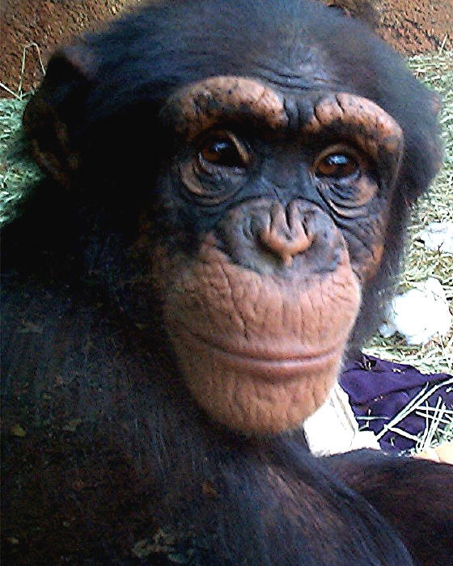
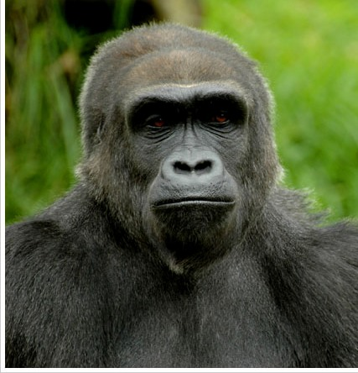
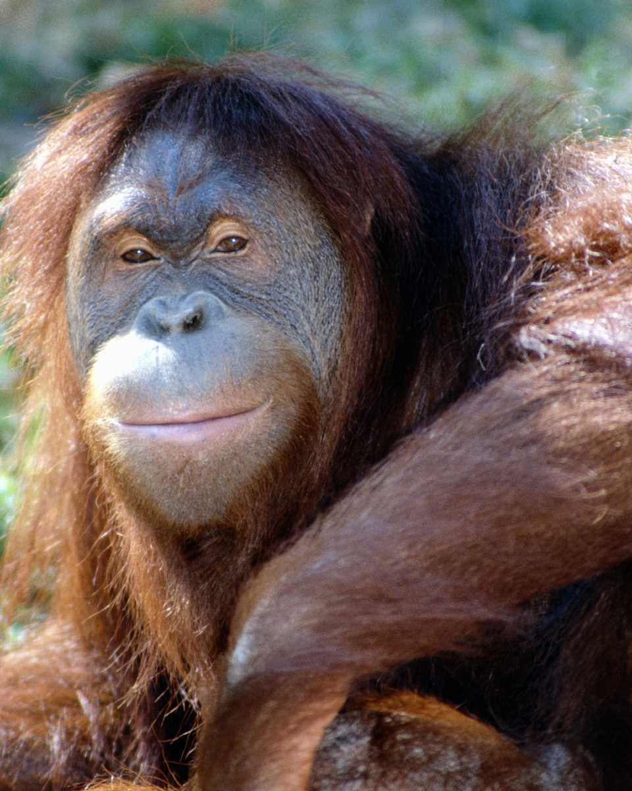
Common Ancestor or Direct Descendent?

Slide 9
Common Ancestor or Direct Descendent?

Slide 10
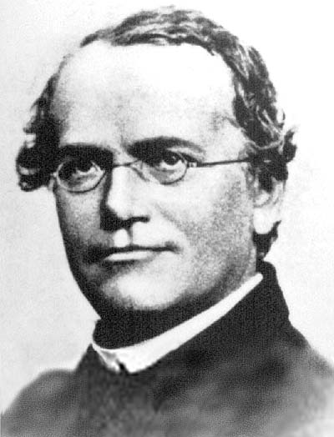
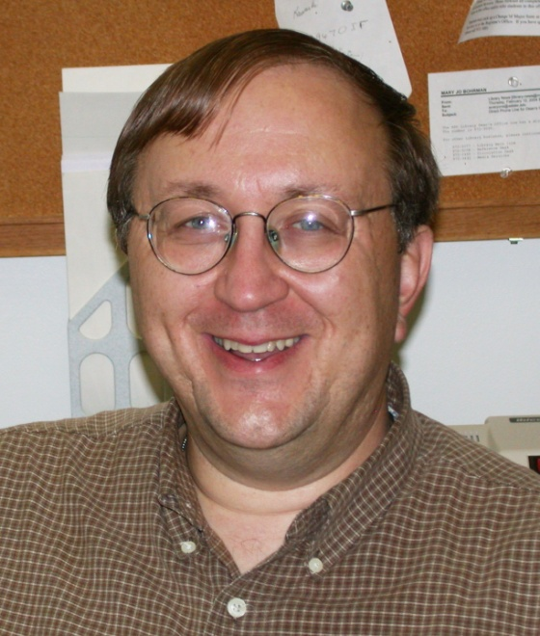
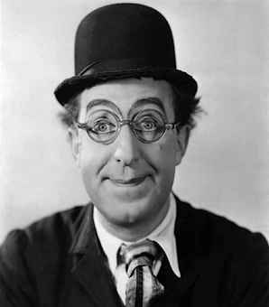
Common Ancestor or Direct Descendent?

Slide 11
Humans and Chimpanzees
Morphologically humans and apes are distinct from one another.
Based on molecular data, isozyme polymorphisms and sequences of mitochondrial and genomic DNA, humans and apes, in particular, chimpanzees are quite similar.
Humans and chimpanzees share 52 % of the same alleles.
Humans and Chimpanzees share the same Blood Type Phenotypes (ABO SYSTEM)
Nucleic acid differences are even less, 1.1 percent difference.
Was the common ancestor to humans and chimpanzees separated by the Great Rift Valley in Africa, leading to allopatric speciation? Humans probably evolved in response to changing environmental conditions as forests gave way to savannas. Some evidence supports this hypothesis, but it is far from conclusive.
According to the Chimpanzee Genome Project, both human (Ardipithecus, Australopithecus and Homo) and chimpanzee (Pan troglodytes and Pan paniscus) lineages diverged from a common ancestor about 5-6 million years ago, if we assume a constant rate of evolution.

Slide 12
Gene study shows chimps more diverse than humans
By Maggie Fox, Health and Science Editor
WASHINGTON (Reuters) - They may all be black and hairy and they may all eat and act in much the same way, but chimpanzees from different parts of Africa are genetically more diverse than all of humanity, researchers reported on Friday.
Experts have long marveled that older ideas of race are not reflected in human DNA. Genetic diversity is more pronounced within population groups than between them, with only a few gene differences accounting for the wide variations seen in eye, skin and hair color across humanity.
So animals all about the same size and color and showing few behavioral differences must be even more genetically identical, right?
Wrong, says Molly Przeworski, assistant professor of human genetics at the University of Chicago.
Her team looked at the DNA of the three designated populations of chimpanzees in Africa -- the eastern, western and central populations, designated by some researchers as sub-species of the chimpanzee.
They found that a western chimpanzee has more differences, genetically, from an eastern chimp than any one human being has from another.
"It is the first genetic confirmation that they are distinct populations," Przeworski said in a telephone interview. "I stay away from the word 'subspecies'." Continued...
© Reuters 2007. All Rights Reserved.
Bonobo apes, primates unique to Congo and humankind's closest relative, groom one another at a sanctuary just outside the capital Kinshasa, in this October 31, 2006 file photo. They may all be black and hairy and they may all eat and act in much the same way, but chimpanzees from different parts of Africa are genetically more diverse than all of humanity, researchers reported on Friday. REUTERS/Finbarr O'Reilly

Slide 13
Trends in Homo Evolution
Increase in brain volume
Increase in size
Skull evolution : vertical face, smaller jaw, round forehead
Bipedalism
Tool development
Cultural development

Slide 14
Our Understanding of Human Evolution is Primarily Based on Fossils

Slide 15
“In each great region of the world the living mammals are
closely related to the extinct species of the same region. It
is , therefore, probable that Africa was formerly inhabited
by extinct apes closely allied to the gorilla and chimpanzee;
And as these two species are now man’s nearest allies,
It is somewhat more probable that our early progenitors
lived on the African continent than elsewhere.”
Charles Darwin
The Descent of Man, 1871

Slide 16
Raymond Dart with Taung skull
Taung child, which was discovered in 1924 in South Africa.
Taung child was originally thought to be a fossil of a child because of its small size.
An endocast of the brain revealed fissures that were more human-like than ape-like.
Australopithecus africanus or “southern ape from Africa”

Slide 17
Robert Broom: One of Dart’s Few Supporters
In 1934, at the age of of 68, Broom gave up his medical practice to take a position at the Transvaal Museum in Pretoria.
In 1936, he decided to search for more of Dart's australopithecines.
Broom recognized two types of australopithecines: gracile and the robust.
In 1948 he started excavating at Swartkrans, which yielded remains of what was later determined to be Homo erectus, as well as further australopithecine fossils.

Slide 18
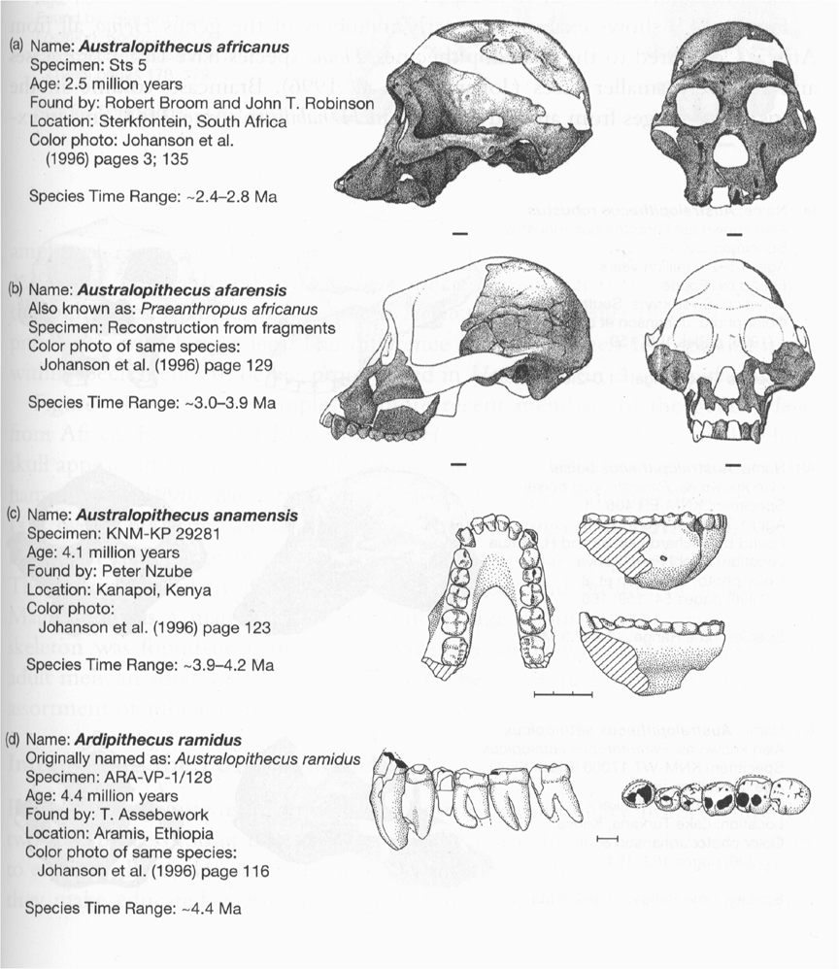
Gracile
Australopithecines

Slide 19
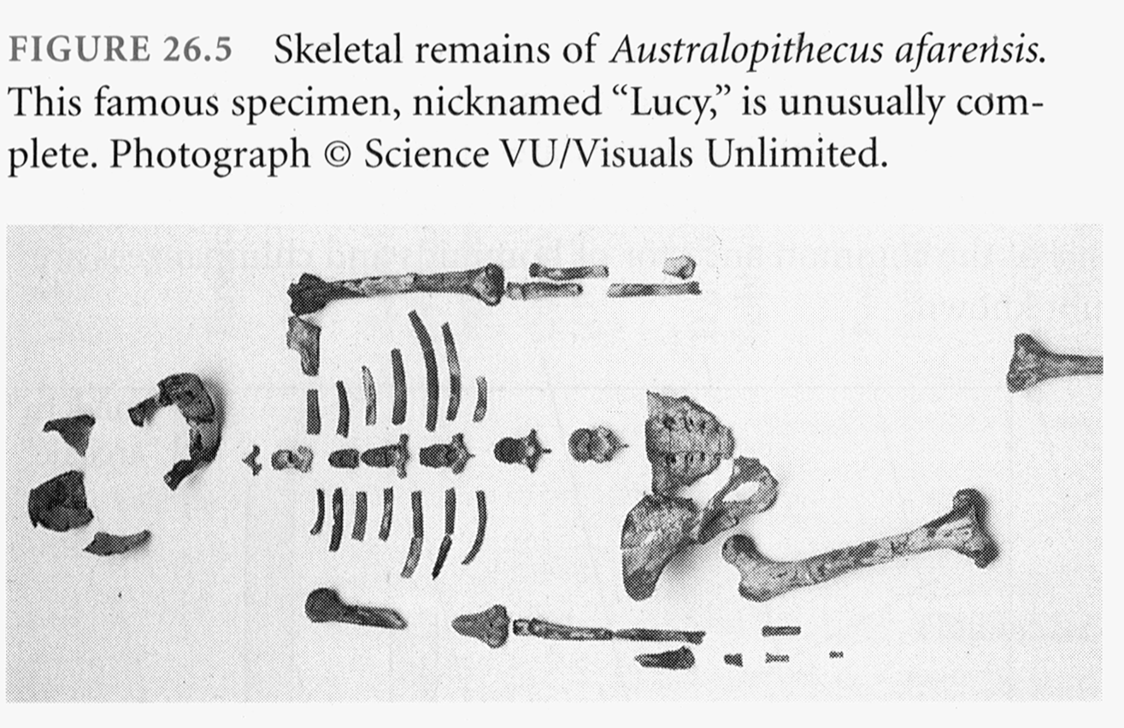

Slide 20
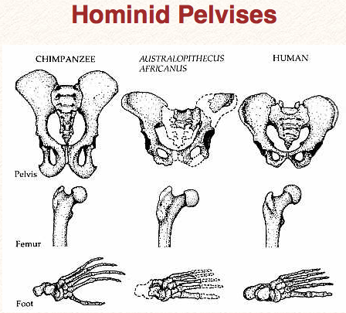

Slide 21
Australopithecus
4.1 mya to 1.2 mya
Bipedal
Foramen magnum faces down
3.6 my footprints found in volcanic ash near afarensis fossil
Large projecting face, small brain case (400 cm³ )
Small in stature (3’7’’ - 4’11’’ ft)
Two distinct lineages (gracile and robust)
May have developed tools

Slide 22
Homo
1.9 mya to present
Larger braincases (cro-magnon: 1600 cm³) than australopithecines and smaller face
Smaller jaws and teeth
Much taller than australopithecines
Development of tools, culture, and
language

Slide 23
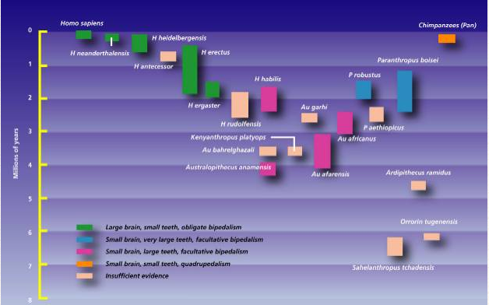

Slide 24
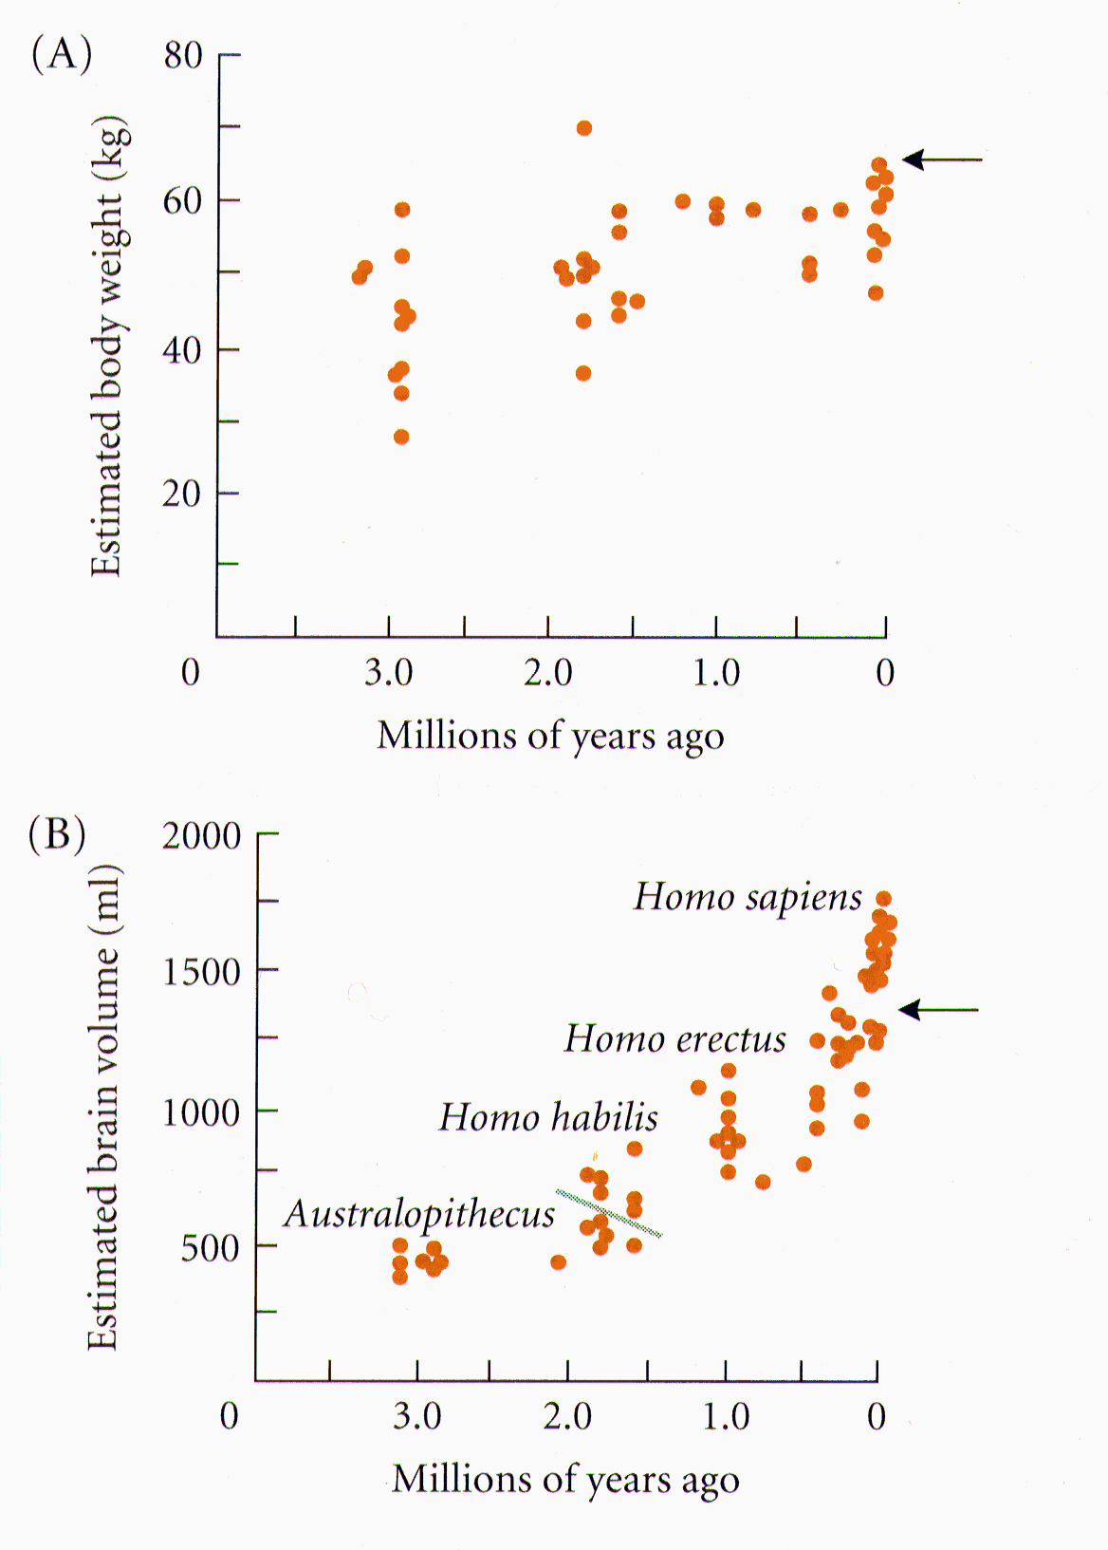
Slight Increase
In Body Size
Much Greater Increase
In Brain Volume

Slide 25
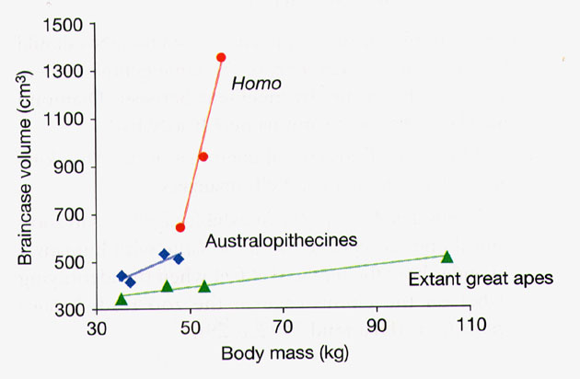
Braincase Volume and Body Mass

Slide 26
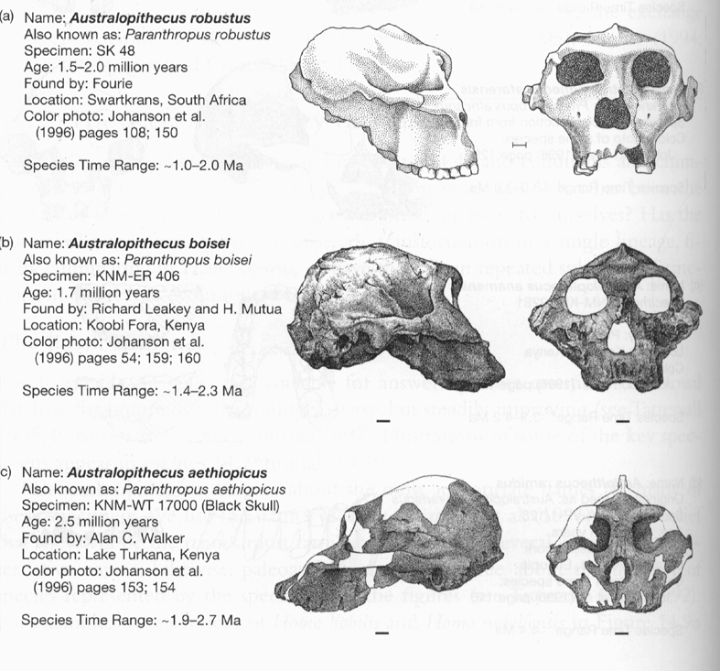
Gracile
Australopithecines
Robust
Australopithecines
Paranthropus

Slide 27
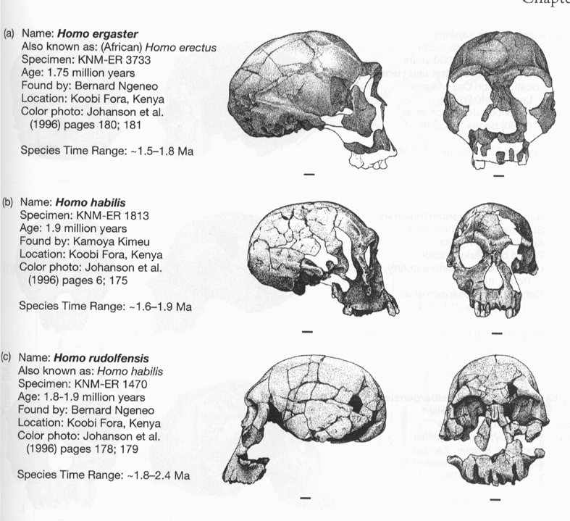
Gracile Australopithecines
Archaic Homo

Slide 28
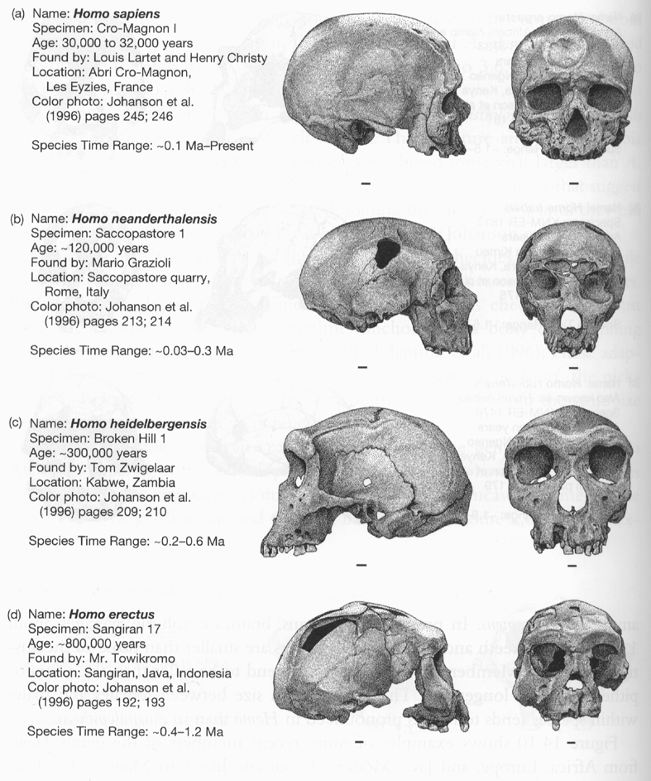
Archaic Homo
Modern Homo

Slide 29
Summary of Hominid Evolution Since
the Chimp/Human Common Ancestor
Frequent speciation produced a diversity
of species
As many as 5 different species may have
coexisted at one time
We are the lone survivors of an otherwise
extinct radiation of bipedal African hominids

Slide 30
What is the Origin of Modern Human Populations?
Multiregional Hypothesis
Homo sapiens evolved from an ancient stock of Homo ergaster/erectus that originated in Africa (~ 1-1.8 mya)
Out of Africa Hypothesis
Homo sapiens evolved from a relatively recent stock of archaic sapiens that originated in Africa (~ 30,000-200,000 ya)

Slide 31
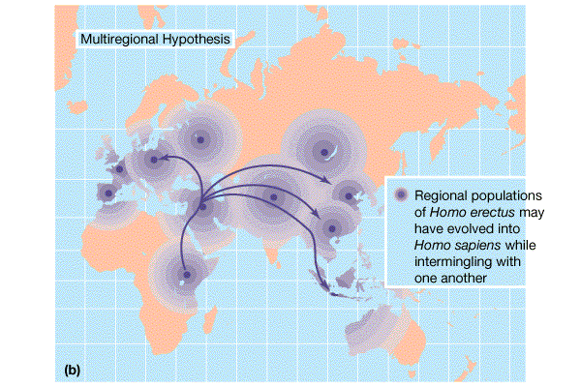

Slide 32
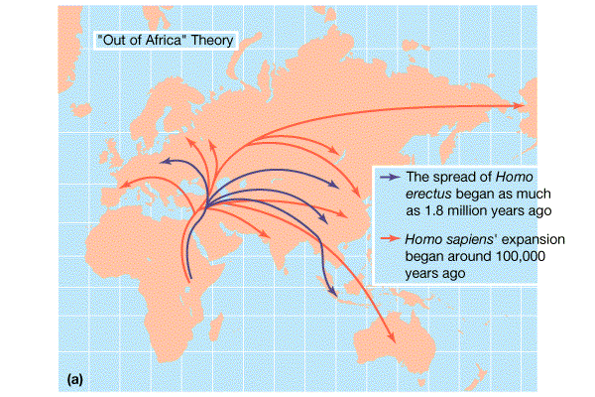

Slide 33
How Can We Test These Hypotheses With Archaic and Contemporary Morphological Data?
Multiregional Hypothesis
Predicts greater morphological similarity between archaic and modern Homo within regions
Out of Africa Hypothesis
Predicts greater morphological similarity between modern forms from different regions than between modern
and archaic forms within regions

Slide 34
Morphological Evidence Is Inconclusive
I. Morphological Support for Multiregional Hypothesis
Frayer et al. 1993. American Anthropologist 95:14-50.
Li Tianyuan and D.A. Etler. 1992. Nature 357:404-407.
II. Morphological Support for Out of Africa Hypothesis
Liberman, D.E. 1995. Current Anthropology 36:159-197.
Waddle, D.M. 1994. Nature 368:452-454.

Slide 35
How Can We Test These Hypotheses With Molecular Data?
Multiregional Hypothesis
Predicts that Homo sapien “eve” existed more than 1 mya.
Out of Africa Hypothesis
Predicts that Homo sapien “eve” existed ~ 30,000-200,000 yr ago.

Slide 36
Molecular Clock Estimate of Divergence Time of Modern Humans
Gene Estimate Reference
mt DNA 166-249,000 Vigilant et al., 1991
mt DNA 129-536,000 Ruvolo et al., 1993
nuclear DNA 75-287,000 Bowcock et al., 1994
mt DNA 125-161,000 Horai et al., 1995
nuclear DNA 102-450,000 Tishkoff et al., 1996

Slide 37
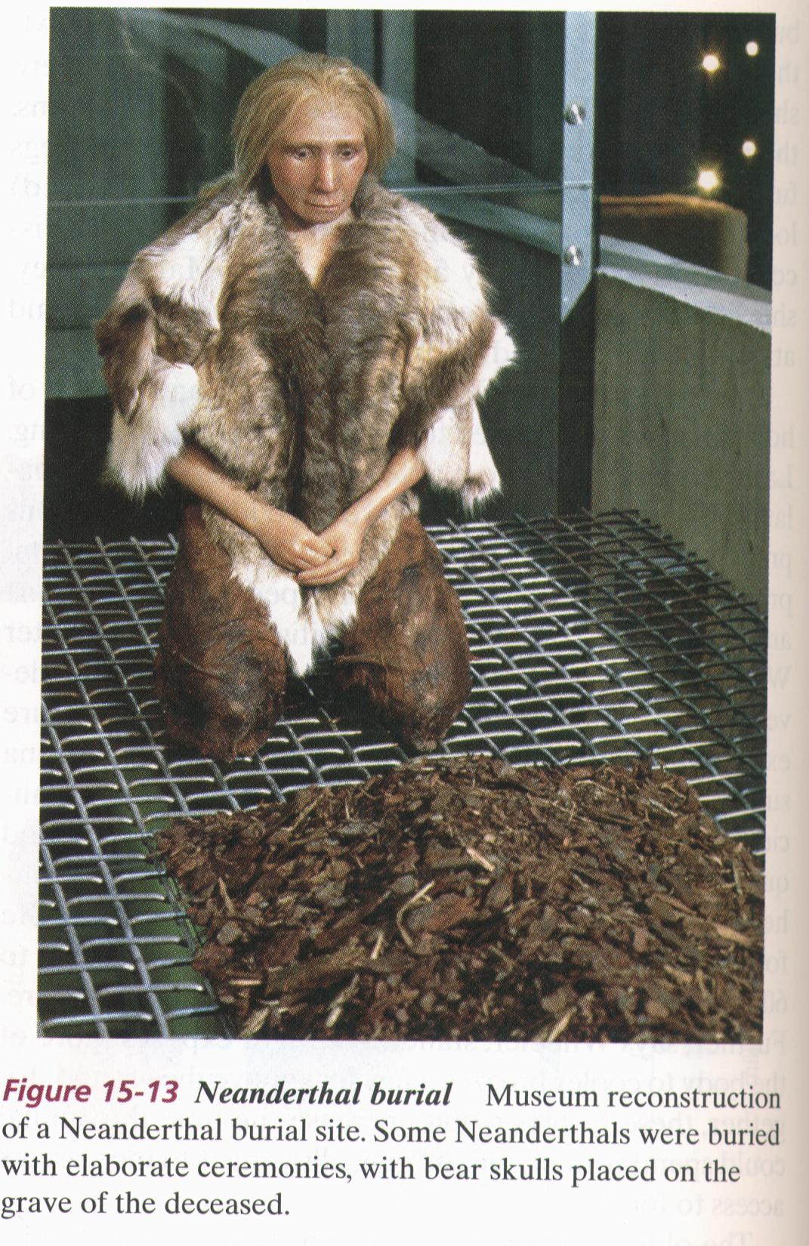
Finally, what about our
relationship to Neandertals?
PCR analysis of Neandertal
fossilized mtDNA suggest that
this was a species distinct
from Homo sapiens.

Slide 38
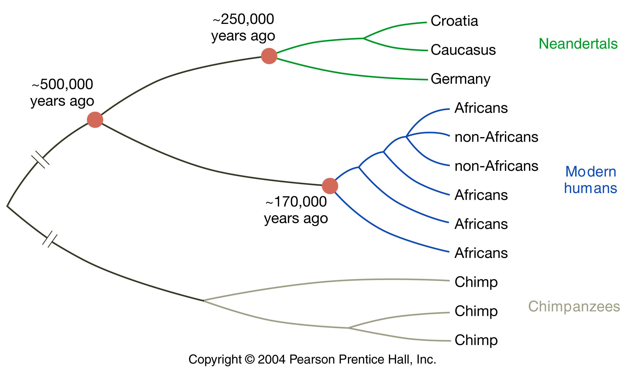
Neanderthals are distinct from Homo sapiens

