Slide 1
Section 1: Darwin’s Theory of Evolution by Natural Selection
Charles Darwin developed a theory of evolution based on natural selection.
K What I Know | W What I Want to Find Out | L What I Learned

Slide 2
Essential Questions
What evidence convinced Darwin that species could change over time?
What are the four principles of natural selection?
How can natural selection change a population?
Darwin’s Theory of Evolution by Natural Selection
Copyright © McGraw-Hill Education

Slide 3
Vocabulary
Review
selective breeding
New
artificial selection
natural selection
evolution
Darwin’s Theory of Evolution by Natural Selection
Copyright © McGraw-Hill Education

Slide 4
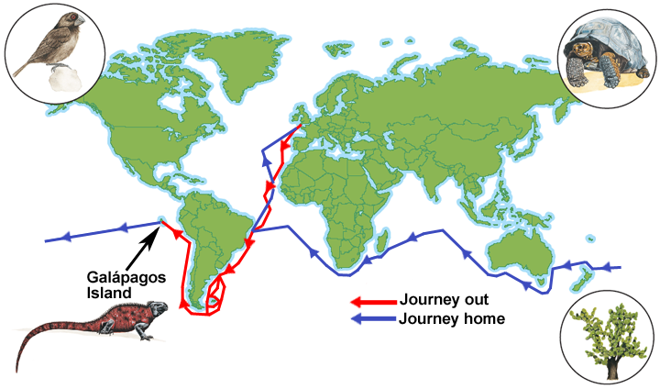
Developing the Theory of Evolution
Darwin on the HMS Beagle
When Darwin began his journey, most people thought the world was ~6000 years old, and that animals and plants were unchanging.
Darwin’s job on the Beagle was to be a naturalist, and to collect biological and geological specimens during the travels.
Darwin’s Theory of Evolution by Natural Selection
Copyright © McGraw-Hill Education

Slide 5
Developing the Theory of Evolution
The Galápagos Islands
Darwin noticed that the different islands all seemed to have their own, slightly different varieties of animals.
Almost every specimen Darwin collected on the Galápagos was new to European scientists, though they were similar to species on mainland South America.
Island and mainland species should not have been so similar, unless mainland species had changed since arriving on the islands.
Darwin’s Theory of Evolution by Natural Selection
Copyright © McGraw-Hill Education

Slide 6
Developing the Theory of Evolution
Darwin continued his studies
Darwin hypothesized that new species could appear gradually through small changes in ancestral species.
Darwin inferred that if humans could change species by artificial selection – directed breeding to produce offspring with desired traits, then perhaps the same process could work in nature.
Darwin’s Theory of Evolution by Natural Selection
Copyright © McGraw-Hill Education

Slide 7
Developing the Theory of Evolution
Natural selection
Darwin described the process of natural selection: some competitors would be better equipped for survival than others, those less equipped would die.
Darwin’s Theory of Evolution by Natural Selection
Copyright © McGraw-Hill Education

Slide 8
Developing the Theory of Evolution
Natural selection
Principles of natural selection:
Individuals show variation
Variations are heritable
More offspring are born than can survive
Variations that increase reproductive success will be more common in the next generation
Darwin’s Theory of Evolution by Natural Selection
Copyright © McGraw-Hill Education

Slide 9
Visualizing Natural Selection
Animation
FPO Add link to animation from page 421(Figure 3) here.
Darwin’s Theory of Evolution by Natural Selection
Copyright © McGraw-Hill Education

Slide 10
Basic Principles of Natural Selection
Interactive Table
FPO Add link to interactive table from page 422 (Table 1) here.
Darwin’s Theory of Evolution by Natural Selection
Copyright © McGraw-Hill Education

Slide 11
The Origin of Species
Darwin published On the Origin of Species by Means of Natural Selection in 1859.
Today, scientists use evolution to mean cumulative change in a group of organisms through time.
Natural selection is not synonymous with evolution – it is a mechanism by which evolution occurs.
Darwin’s Theory of Evolution by Natural Selection
Copyright © McGraw-Hill Education

Slide 12
Review
Essential Questions
What evidence convinced Darwin that species could change over time?
What are the four principles of natural selection?
How can natural selection change a population?
Vocabulary
artificial selection
natural selection
evolution
Darwin’s Theory of Evolution by Natural Selection
Copyright © McGraw-Hill Education

