Slide 1
Section 2: DNA Technology
Researchers use genetic engineering to manipulate DNA.
K What I Know | W What I Want to Find Out | L What I Learned

Slide 2
Essential Questions
What are the different tools and processes used in genetic engineering?
How does genetic engineering manipulate recombinant DNA?
What are the similarities between selective breeding and genetic engineering?
How can genetic engineering and biotechnology be used to improve human life?
DNA Technology
Copyright © McGraw-Hill Education

Slide 3
Vocabulary
Review
DNA
New
genetic engineering
genome
restriction enzyme
gel electrophoresis
recombinant DNA
plasmid
DNA ligase
transformation
cloning
polymerase chain reaction
transgenic organism
DNA Technology
Copyright © McGraw-Hill Education

Slide 4
Genetic Engineering
Genetic engineering is technology that involves manipulating the DNA of one organism in order to insert the DNA of another organism.
The inserted DNA of another organism is known as exogenous DNA.
DNA Technology
Copyright © McGraw-Hill Education

Slide 5
Genetic Engineering
Genetically engineered organisms are used to:
Study the expression of a particular gene
Investigate cellular processes
Study the development of a certain disease
Select traits that might be beneficial to humans
DNA Technology
Copyright © McGraw-Hill Education

Slide 6
DNA Tools
Genetic engineering can be used to increase/decrease the expression of specific genes in selected organisms.
An organism’s genome is the total DNA in the nucleus of each cell.
DNA tools can be used to manipulate DNA and to isolate genes from the rest of the genome.
DNA Technology
Copyright © McGraw-Hill Education

Slide 7
DNA Tools
Restriction enzymes
Restriction enzymes are proteins that recognize and bind to specific DNA sequences and cleave the DNA within that sequence.
They are used as a defense mechanism by bacteria against viruses.
Scientists use restriction enzymes as powerful tools for isolating specific genes or regions of the genome.
DNA Technology
Copyright © McGraw-Hill Education

Slide 8
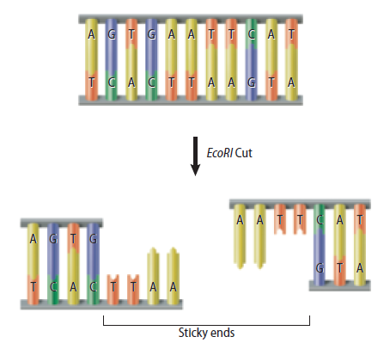
DNA Tools
EcoRI
EcoRI is a restriction enzyme that specifically cuts DNA containing the sequence GAATTC.
Sticky ends are single stranded DNA sequences at the end of fragments.
Can be reattached to complementary strands
DNA Technology
Copyright © McGraw-Hill Education

Slide 9
Restriction Enzymes
Animation
FPO Add link to animation from page 364 (Figure 4) here.
DNA Technology
Copyright © McGraw-Hill Education

Slide 10
DNA Tools
Gel electrophoresis
An electric current is used to separate DNA fragments according to the size of the fragments in a process called gel electrophoresis.
When an electric current is applied, the DNA fragments move toward the positive end of the gel.
The smaller fragments move farther faster than the larger ones.
The unique pattern created based on the size of the DNA fragment can be compared to known DNA fragments for identification.
DNA Technology
Copyright © McGraw-Hill Education

Slide 11
Recombinant DNA Technology
DNA fragments from different sources can be combined to make new DNA molecules.
The newly generated DNA molecule with DNA from different sources is called recombinant DNA.
DNA Technology
Copyright © McGraw-Hill Education

Slide 12
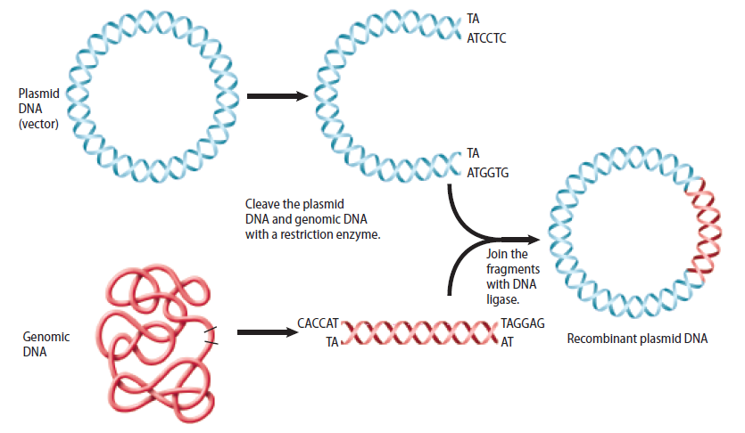
Recombinant DNA Technology
Recombinant DNA is placed into bacterial cells for study via a carrier.
Common carriers include viruses and plasmids – small, circular, double-stranded DNA molecules that occur naturally in bacteria and yeasts.
DNA ligase, a cellular repair enzyme, attaches the recombinant DNA to the plasmid.
DNA Technology
Copyright © McGraw-Hill Education

Slide 13
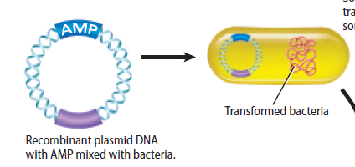
Recombinant DNA Technology
Gene cloning
To make a large quantity of recombinant plasmid DNA, bacterial cells are mixed with recombinant plasmid DNA.
Some of the bacterial cells take up the recombinant plasmid DNA through a process called transformation.
DNA Technology
Copyright © McGraw-Hill Education

Slide 14
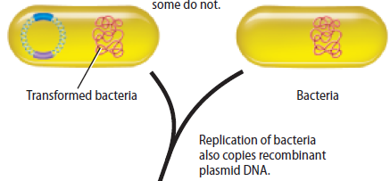
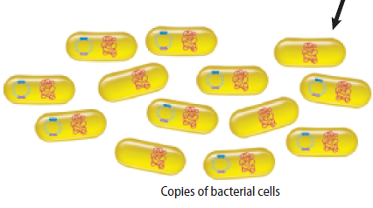
Recombinant DNA Technology
Gene cloning
Bacteria that take up the plasmid make copies of the recombinant DNA during cell replication.
Large numbers of identical bacteria containing recombinant DNA can be produced through this process called cloning.
DNA Technology
Copyright © McGraw-Hill Education

Slide 15
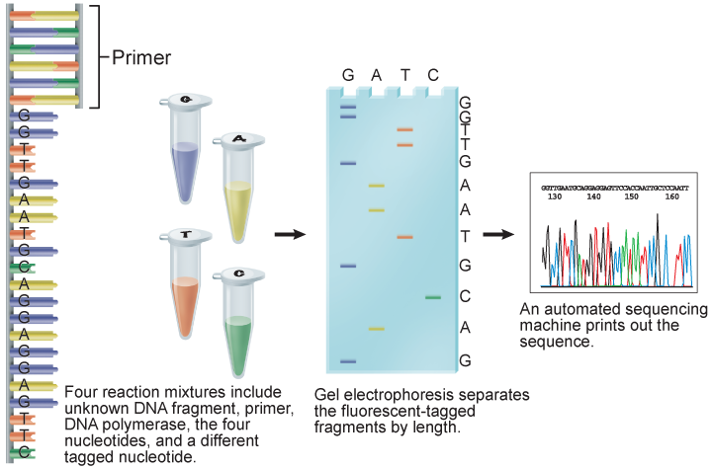
Recombinant DNA Technology
DNA sequencing
Scientists study DNA sequences with DNA fragments, DNA polymerase, fluorescently labeled nucleotides, and gel electrophoresis.
DNA Technology
Copyright © McGraw-Hill Education

Slide 16
Recombinant DNA Technology
Polymerase chain reaction
Once the sequence of a DNA fragment is known, a technique called the polymerase chain reaction (PCR) can be used to make millions of copies of a specific region of a DNA fragment.
PCR can copy or amplify a single DNA molecule numerous times for use in analysis.
DNA Technology
Copyright © McGraw-Hill Education

Slide 17
Polymerase Chain Reaction
Animation
FPO Add link to animation from page 369 (Figure 9) here.
DNA Technology
Copyright © McGraw-Hill Education

Slide 18
Genetic Engineering
Interactive Table
FPO Add link to interactive table from page 370 (table 1) here.
DNA Technology
Copyright © McGraw-Hill Education

Slide 19
Biotechnology
Biotechnology is the use of genetic engineering to find solutions to problems.
Organisms with genes from other organisms are called transgenic organisms.
Transgenic animals, plants, and bacteria are used for research, medicine, and agriculture.
DNA Technology
Copyright © McGraw-Hill Education

Slide 20
Biotechnology
Transgenic animals
Scientists produce most transgenic animals in laboratories for biological research.
They are used to:
Study diseases
Improve food supply
Improve human health
Be potential sources of organs for transplant
DNA Technology
Copyright © McGraw-Hill Education

Slide 21
Biotechnology
Transgenic plants
Frequently genetically engineered for resistance against insect or viral pests.
Other transgenic plants are designed to:
Reduce allergic reactions in humans
Contain increased vitamin and mineral content
Resist extreme weather
Produce vaccines or biodegradable plastics
DNA Technology
Copyright © McGraw-Hill Education

Slide 22
Biotechnology
Transgenic bacteria
Transgenic bacteria can:
Produce insulin and growth hormones
Slow the formation of ice on crops
Clean up oil spills
Decompose garbage
DNA Technology
Copyright © McGraw-Hill Education

Slide 23
Review
Essential Questions
What are the different tools and processes used in genetic engineering?
How does genetic engineering manipulate recombinant DNA?
What are the similarities between selective breeding and genetic engineering?
How can genetic engineering and biotechnology be used to improve human life?
Vocabulary
genetic engineering
genome
restriction enzyme
gel electrophoresis
recombinant DNA
plasmid
DNA ligase
transformation
cloning
polymerase chain reaction
transgenic organism
DNA Technology
Copyright © McGraw-Hill Education

