Slide 1

Section 2: Evidence of Evolution
Multiple lines of evidence support the theory of evolution.
K What I Know | W What I Want to Find Out | L What I Learned

Slide 2
Essential Questions
How do fossils provide evidence of evolution?
How does morphology provide evidence of evolution?
How does biochemistry provide evidence of evolution?
Evidence of Evolution
Copyright © McGraw-Hill Education

Slide 3
Vocabulary
Review
fossil
New
derived trait
ancestral trait
homologous structure
vestigial structure
analogous structure
embryo
biogeography
fitness
camouflage
mimicry
Evidence of Evolution
Copyright © McGraw-Hill Education

Slide 4
Support for Evolution
The theory of evolution states that all organisms on Earth have descended from a single ancestor.
Recall that theories provide explanations for natural phenomena based on observation.
Darwin’s On the Origin of Species demonstrated how evolution might happen, and evidence of its occurrence.
Evidence of Evolution
Copyright © McGraw-Hill Education

Slide 5
Support for Evolution
Evidence for evolution comes from:
  The fossil record
  Comparative anatomy
  Comparative embryology
  Comparative biochemistry
  Geographic distribution
Evidence of Evolution
Copyright © McGraw-Hill Education

Slide 6
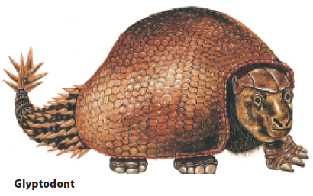
Support for Evolution
The fossil record
Fossils show modern species resemble ancient species.
They also reveal that some species have changed very little.
The fossil record is an important source of information for determining the ancestry of organisms and the patterns of evolution.
The glyptodont was an ancient ancestor of the modern armadillo.
Evidence of Evolution
Copyright © McGraw-Hill Education

Slide 7
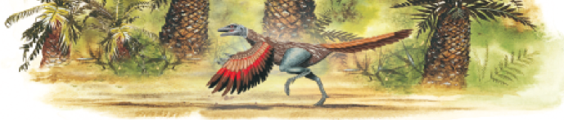
Support for Evolution
The fossil record
Darwin predicted the existence of fossils intermediate in form between species, such as Archaeopteryx.
Researchers consider two major classes of traits when studying transitional fossils:
  Derived traits are newly evolved features, such as feathers, that do not appear in the fossils of common ancestors.
  Ancestral traits are more primitive features, such as teeth and tails, that do appear in ancestral forms.
Evidence of Evolution
Copyright © McGraw-Hill Education

Slide 8
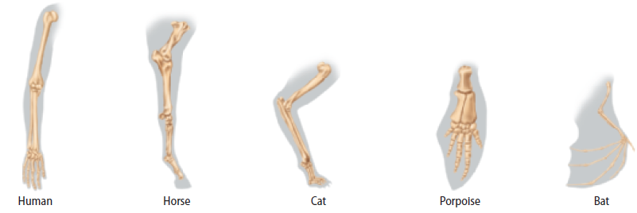
Support for Evolution
Comparative anatomy
Anatomically similar structures inherited from a common ancestor are called homologous structures.
Evolution predicts that an organism’s body parts are more likely to be modifications of ancestral body parts than entirely new structures.
Evidence of Evolution
Copyright © McGraw-Hill Education

Slide 9
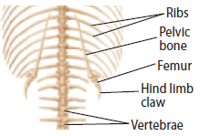
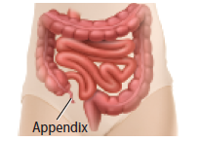
Support for Evolution
Comparative anatomy
Vestigial structures are structures that are the reduced forms of functional structures in other organisms.
Evolutionary theory predicts that features of ancestors that no longer have a function for that species will become smaller over time until they are lost.
snake pelvis
human appendix
Evidence of Evolution
Copyright © McGraw-Hill Education

Slide 10
Vestigial Structures
Interactive Table
FPO Add link interactive table from page 425 (Table 2) here.
Evidence of Evolution
Copyright © McGraw-Hill Education

Slide 11
Support for Evolution
Comparative anatomy
Analogous structures can be used for the same purpose and be superficially similar in construction, but are not inherited from a common ancestor.
Analogous structures show that functionally similar features can evolve independently under similar conditions.
Evidence of Evolution
Copyright © McGraw-Hill Education

Slide 12
Support for Evolution
Comparative embryology
An embryo is an early, pre-birth stage of an organism’s development.
Vertebrate embryos exhibit homologous structures during phases of development that become totally different structures in the adult forms.
Evidence of Evolution
Copyright © McGraw-Hill Education

Slide 13

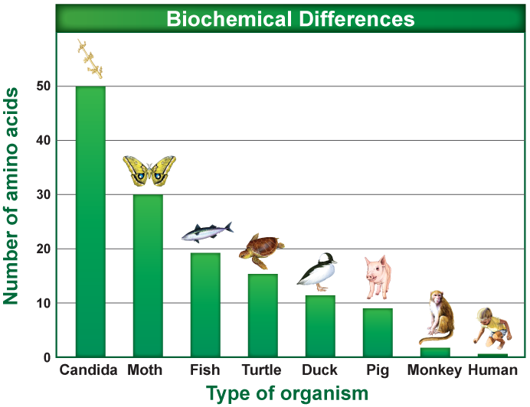
Support for Evolution
Comparative biochemistry
Common ancestry can be seen in the complex metabolic molecules that many different organisms share.
The more closely related species are to each other, the greater the biochemical similarity.
Evidence of Evolution
Copyright © McGraw-Hill Education

Slide 14
Support for Evolution
Geographic distribution
The distribution of plants and animals were what first suggested evolution to Darwin.
The distribution of plants and animals around the world is studied in the field of biogeography.
Evolution is linked to migration patterns, climate, and geological forces (such as plate tectonics).
Evidence of Evolution
Copyright © McGraw-Hill Education

Slide 15
Adaptation
Types of adaptations
An adaptation is a trait shaped by natural selection that increases an organism’s reproductive success.
Fitness is a measure of the relative contribution an individual trait makes to the next generation.
The better an organism is adapted to its environment, the greater its chances of survival and reproductive success.
Evidence of Evolution
Copyright © McGraw-Hill Education

Slide 16
Adaptation
Types of adaptations
Camouflage is a suite of morphological adaptations that allow an organism to blend into its environment.
Mimicry is a type of morphological adaptation where a species evolves to resemble another species.
Antimicrobial resistance develops in some bacteria in response to sub-lethal exposure to antibiotics.
Evidence of Evolution
Copyright © McGraw-Hill Education

Slide 17
Adaptation
Consequences of adaptations
Not all features of an organism are necessarily adaptive.
Some features are consequences of other evolved characteristics.
  Helplessness of human babies: humans give birth at a much early developmental stage than other primates.
  May be a consequence of larger brain size and upright posture
Evidence of Evolution
Copyright © McGraw-Hill Education

Slide 18
Review
Essential Questions
How do fossils provide evidence of evolution?
How does morphology provide evidence of evolution?
How does biochemistry provide evidence of evolution?
Vocabulary
derived trait
ancestral trait
homologous structure
vestigial structure
analogous structure
embryo
biogeography
fitness
camouflage
mimicry
Evidence of Evolution
Copyright © McGraw-Hill Education

