Slide 1
Section 3: Gene Linkage and Polyploidy
The crossing over of linked genes is a source of genetic variation.
K What I Know | W What I Want to Find Out | L What I Learned

Slide 2
Essential Questions
How does the process of meiosis produce genetic recombination?
How can gene linkage be used to create chromosome maps?
Why is polyploidy important to the field of agriculture?
Gene Linkage and Polyploidy
Copyright © McGraw-Hill Education

Slide 3
Vocabulary
Review
protein
New
genetic recombination
polyploidy
Gene Linkage and Polyploidy
Copyright © McGraw-Hill Education

Slide 4
Genetic Recombination
The new combination of genes produced by crossing over and independent assortment is called genetic recombination.
Combinations of genes due to independent assortment can be calculated using the formula 2^{n}, where n is the number of chromosome pairs.
Any possible male gamete can fertilize any possible female gamete, so the possible combinations after fertilization are 2^{n} X 2^{n}.
Gene Linkage and Polyploidy
Copyright © McGraw-Hill Education

Slide 5
Gene Linkage
Genes located close to each other on the same chromosome are said to be linked.
They usually travel together during gamete formation.
Gene linkage results in an exception to Mendel’s law of independent assortment.
Gene Linkage and Polyploidy
Copyright © McGraw-Hill Education

Slide 6
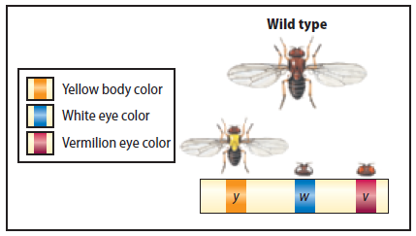
Gene Linkage
Chromosome maps
Crossing over occurs more frequently between genes that are farther apart.
Cross over data can be used to create chromosome maps, depictions of how genes are arranged on a chromosome.
Gene Linkage and Polyploidy
Copyright © McGraw-Hill Education

Slide 7
Polyploidy
Polyploidy is the occurrence of one or more extra sets of all chromosomes in an organism.
A triploid organism is designated 3n, which means that it has three complete sets of chromosomes.
Many agricultural crops are polyploid.
Wheat (6n), oats (6n), and sugar cane (8n)
Polyploid plants often have increased vigor and size
Gene Linkage and Polyploidy
Copyright © McGraw-Hill Education

Slide 8
Review
Essential Questions
How does the process of meiosis produce genetic recombination?
How can gene linkage be used to create chromosome maps?
Why is polyploidy important to the field of agriculture?
Vocabulary
genetic recombination
polyploidy
Gene Linkage and Polyploidy
Copyright © McGraw-Hill Education

