Slide 1

Section 4: Gene Regulation and Mutation
Gene expression is regulated by the cell, and mutations can affect this expression.
K What I Know | W What I Want to Find Out | L What I Learned

Slide 2
Essential Questions
How are bacteria able to regulate their genes by two types of operons?
How do eukaryotes regulate the transcription of genes?
What are the various types of mutations?
Gene Regulation and Mutation
Copyright © McGraw-Hill Education

Slide 3
Vocabulary
Review
prokaryote
New
gene regulation
operon
mutation
mutagen
Gene Regulation and Mutation
Copyright © McGraw-Hill Education

Slide 4
Prokaryote Gene Regulation
Gene regulation is the ability of an organism to control which genes are transcribed in response to the environment.
An operon is a section of DNA that contains the genes for the proteins needed for a specific metabolic pathway.
An operon contains:
  Operator – on/off switch
  Promoter – where RNA polymerase binds
  Regulatory gene
  Genes coding for proteins
Gene Regulation and Mutation
Copyright © McGraw-Hill Education

Slide 5
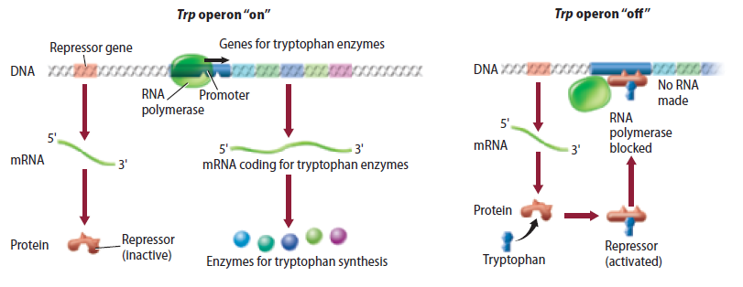
Prokaryote Gene Regulation
The trp operon
Tryptophan synthesis occurs in five steps controlled by the trp operon.
The trp operon is a repressible operon, because it is usually repressed or turned off.
Gene Regulation and Mutation
Copyright © McGraw-Hill Education

Slide 6
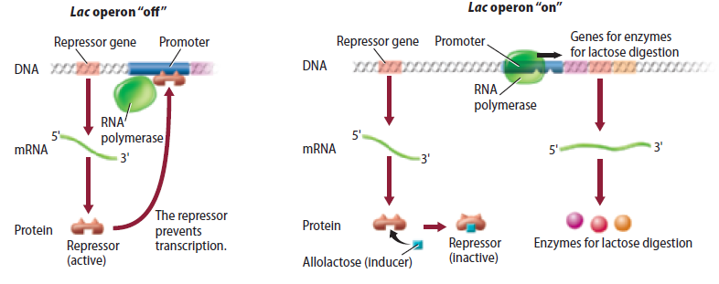
Prokaryote Gene Regulation
The lac operon
When lactose is present, E. coli can synthesize an enzyme to use it as an energy source.
The lac operon is an inducible operon because an inducer binds to the repressor and inactivates it, allowing transcription to be turned on.
Gene Regulation and Mutation
Copyright © McGraw-Hill Education

Slide 7
Gene Regulation
Animation
FPO Add link to animation from page 342/343(Figure 18) here.
Gene Regulation and Mutation
Copyright © McGraw-Hill Education

Slide 8
Eukaryote Gene Regulation
Controlling transcription
Transcription factors ensure that a gene is used at the right time and that proteins are made in the right amounts.
  Complexes that guide the binding of the RNA polymerase to a promoter
  Regulatory proteins that help control the rate of transcription
The complex structure of eukaryotic DNA also regulates transcription.
Gene Regulation and Mutation
Copyright © McGraw-Hill Education

Slide 9
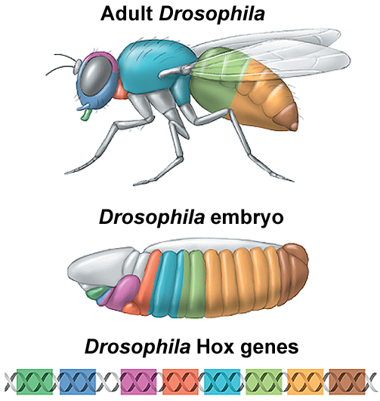
Eukaryote Gene Regulation
Hox genes
Gene regulation is crucial during development and cell differentiation.
One group of genes that control cell differentiation is the homeobox (Hox) gene group.
Hox genes are transcribed at specific times in specific places on the genome, and control what body part will develop at a giving body location.
Gene Regulation and Mutation
Copyright © McGraw-Hill Education

Slide 10
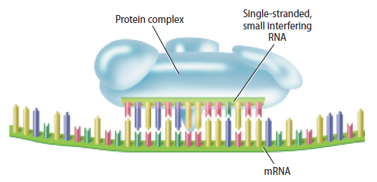
Eukaryote Gene Regulation
RNA interference
RNA interference (RNAi) can stop the mRNA from translating its message.
Single-stranded small interfering RNA and protein complexes bind to mRNA and stop translation.
Gene Regulation and Mutation
Copyright © McGraw-Hill Education

Slide 11
Mutations
Types of mutations
A permanent change that occurs in a cell’s DNA is called a mutation.
Point mutation: involve chemical change to just one base pair
  Missense substitutions: DNA codes for the wrong amino acid
  Nonsense mutation: Codon for amino acid becomes a stop codon
Insertion/deletion: additions/ loss of a nucleotide to the DNA sequence
  Cause “frameshifts”
Gene Regulation and Mutation
Copyright © McGraw-Hill Education

Slide 12
Mutations
Interactive Table
FPO Add link to interactive table from page 346 (Table 3) here.
Gene Regulation and Mutation
Copyright © McGraw-Hill Education

Slide 13
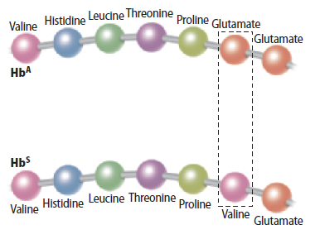
Mutations
Protein folding and stability
Even small changes in the DNA code can cause genetic disorders.
The change in one amino acid can change the sequence of the protein enough to affect both the folding and stability of the protein.
Gene Regulation and Mutation
Copyright © McGraw-Hill Education

Slide 14
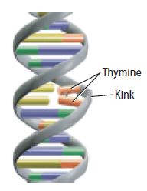
Mutations
Causes of mutation
Can occur spontaneously – DNA polymerase can attach the wrong nucleotide, but this is rare and usually corrected.
Certain chemicals and radiation called mutagens can damage DNA.
  Chemicals can cause mispairing of base pairs, or themselves substitute for base pairs.
  High-energy radiation can eject electrons from atoms within the DNA molecule, leaving behind unstable free radicals.
Gene Regulation and Mutation
Copyright © McGraw-Hill Education

Slide 15
Mutations
Body-cell v. sex-cell mutation
Somatic cell mutations are not passed on to the next generation.
Mutations that occur in sex cells are passed on to the organism’s offspring and will be present in every cell of the offspring.
Gene Regulation and Mutation
Copyright © McGraw-Hill Education

Slide 16
Review
Essential Questions
How are bacteria able to regulate their genes by two types of operons?
How do eukaryotes regulate the transcription of genes?
What are the various types of mutations?
Vocabulary
gene regulation
operon
mutation
mutagen
Gene Regulation and Mutation
Copyright © McGraw-Hill Education

