Slide 1

Section 4: Geologic Time
Relative dating and absolute dating are used to infer Earth’s geologic past.
K What I Know | W What I Want to Find Out | L What I Learned

Slide 2
Essential Questions
What are geologic epochs, periods, and eras?
What are the characteristics of the main geologic eras?
Which geologic laws are used to determine relative age?
What methods are used to determine absolute age?
Geologic Time
Copyright © McGraw-Hill Education

Slide 3
Vocabulary
Review
radioactivity
New
absolute dating
relative dating
uniformitarianism
principle of superposition
unconformity
fossil
Geologic Time
Copyright © McGraw-Hill Education

Slide 4
Measuring Time
Absolute and relative dating
Absolute dating is the process of assigning a precise numerical age to an organism, object, or event.
Relative dating is the process of placing objects or events in their proper sequence in time.
Geologic Time
Copyright © McGraw-Hill Education

Slide 5
Measuring Time
Uniformitarianism
Uniformitarianism states that the laws of nature operate today as they have in the past.
Studying geologic processes that take place today, help scientists infer how such processes took place in the past.
Geologic Time
Copyright © McGraw-Hill Education

Slide 6
Principles of Relative Age Dating
Principle of superposition
Principle of superposition states in an undisturbed sequence of sedimentary rock layers the youngest rocks will be at the top and the oldest will be at the bottom of the sequence.
Original Horizontality
Sedimentary layers always start off as horizontal layers.
Geologic Time
Copyright © McGraw-Hill Education

Slide 7
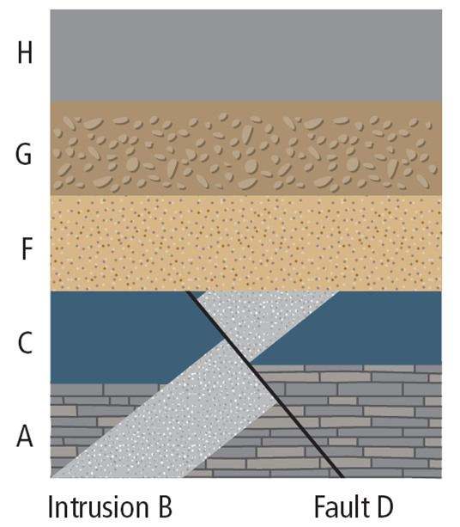
Principles of Relative Age Dating
Cross-cutting relationships
The principle of cross cutting relationships states that any rock formation or fault is younger than the rock or feature that it cuts through.
Geologic Time
Copyright © McGraw-Hill Education

Slide 8
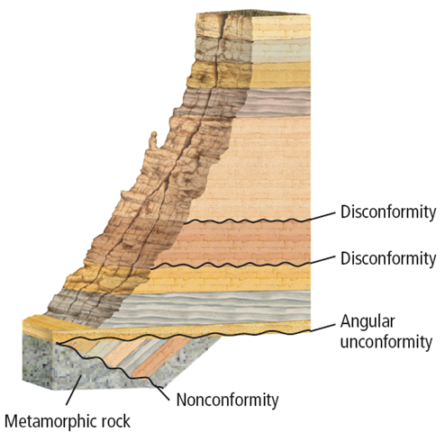
Principles of Relative Age Dating
Unconformities
Unconformities represent gaps in the rock record during which erosion occurred or deposition was absent.
A disconformity is an erosional surface between two horizontal rock layers.
Geologic Time
Copyright © McGraw-Hill Education

Slide 9
Principles of Relative Age Dating
Unconformities
An angular unconformity is an erosional surface between rock layer segments that intercept at an angle.
A nonconformity is an erosional surface between sedimentary rock and igneous or metamorphic rock.
Geologic Time
Copyright © McGraw-Hill Education

Slide 10
Angular Unconformity
Animation
FPO Add link to animation from page 871 here.
Geologic Time
Copyright © McGraw-Hill Education

Slide 11
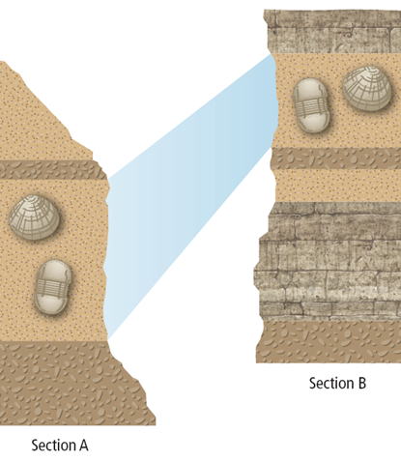
Fossils
The remains or traces of organisms found in the geologic rock record are called fossils.
Fossil correlation
The process of matching distinctive rock units from different regions is called correlation.
Geologic Time
Copyright © McGraw-Hill Education

Slide 12
Fossils
BrainPOP
FPO Add link to animation from page 871 here.
Geologic Time
Copyright © McGraw-Hill Education

Slide 13
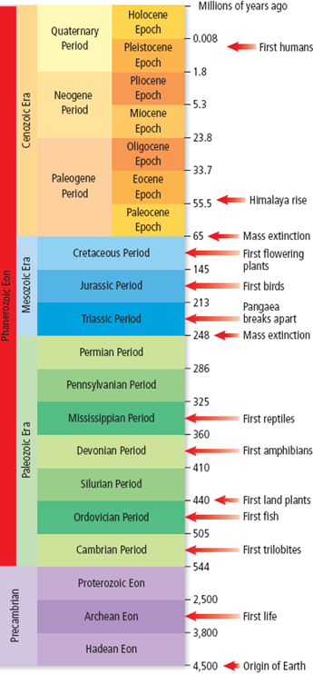
Geologic Time Scale
Paleontologists observe changes in the fossil record and associate them with boundaries of time units.
At these boundaries, fossils of certain life forms are no longer present and new life forms begin to appear.
Geologic Time
Copyright © McGraw-Hill Education

Slide 14
Geologic Time Scale
Animation
FPO Add link to animation from page 872 here.
Geologic Time
Copyright © McGraw-Hill Education

Slide 15
Absolute Age Dating
Some types of atoms are unstable and decay by casting off, or emitting, parts of their nuclei.
The half-life is the time it takes for one-half of a radioactive parent isotope to decay to a stable daughter isotope.
Geologic Time
Copyright © McGraw-Hill Education

Slide 16
Review
Essential Questions
What are geologic epochs, periods, and eras?
What are the characteristics of the main geologic eras?
Which geologic laws are used to determine relative age?
What methods are used to determine absolute age?
Vocabulary
absolute dating
relative dating
uniformitarianism
principle of superposition
unconformity
fossil
Geologic Time
Copyright © McGraw-Hill Education

