Slide 1

Section 2: Modern Classification
Classification systems have changed over time as information has increased.
K What I Know | W What I Want to Find Out | L What I Learned

Slide 2
Essential Questions
What are the similarities and differences between species concepts?
What are the methods used to reveal phylogeny?
How is a cladogram constructed?
Modern Classification
Copyright © McGraw-Hill Education

Slide 3
Vocabulary
Review
evolution
New
phylogeny
character
molecular clock
cladistics
cladogram
Modern Classification
Copyright © McGraw-Hill Education

Slide 4
Determining Species
Typological species concept
The concept of what determines a species has changed through time.
Aristotle and Linnaeus used the typological species concept – each species a distinctly different group of organisms based on physical similarities.
Based on the idea that species are unchanging, distinct, and natural types.
Modern Classification
Copyright © McGraw-Hill Education

Slide 5
Determining Species
Biological species concept
The biological species concept defines a species as a group of organisms that is able to interbreed and produce fertile offspring in a natural setting.
Does not account for extinct species or species that reproduce asexually.
Modern Classification
Copyright © McGraw-Hill Education

Slide 6
Determining Species
Phylogenetic species concept
Phylogeny is the evolutionary history of a species.
The phylogenetic species concept defines a species as a cluster of organisms that is distinct from other clusters and shows evidence of a pattern of ancestry and descent.
Modern Classification
Copyright © McGraw-Hill Education

Slide 7
Species Concepts
Interactive Table
FPO Add link interactive table from page 491(Table 2) here.
Modern Classification
Copyright © McGraw-Hill Education

Slide 8
Characters
To classify a species, scientists construct patterns of descent by using characters – inherited features that vary among species.
Characters can be morphological or biochemical.
Modern Classification
Copyright © McGraw-Hill Education

Slide 9
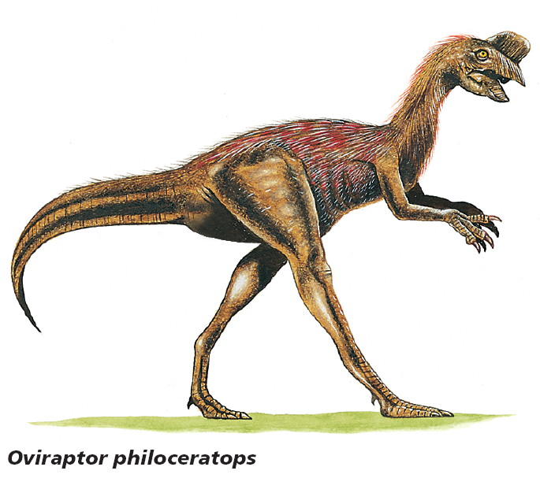
Characters
Morphological characters
Shared morphological characters suggest that species are related closely and evolved from a recent common ancestor.
Birds and dinosaurs:
  Modern birds may not look closely related to dinosaurs.
  Both birds and dinosaurs have hollow bones.
  Theropods have hip, leg, wrist, and shoulder structures more similar to birds than living reptiles.
Modern Classification
Copyright © McGraw-Hill Education

Slide 10


Characters
Biochemical characters
Scientists use biochemical characters, such as amino acids and nucleotides, to help them determine evolutionary relationships among species.
DNA and RNA analyses are powerful tools for reconstructing phylogenies.
Chimpanzee
Gorilla
Orangutan
Modern Classification
Copyright © McGraw-Hill Education

Slide 11
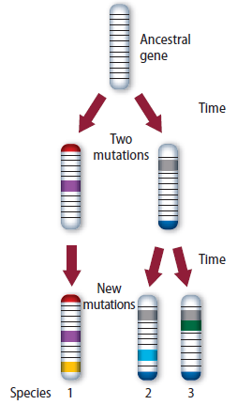
Characters
Biochemical characters
A molecular clock is a model that is used to estimate the amount of time it has taken for species to evolve from a common ancestor.
Scientists use molecular clocks to compare DNA sequences between species – the more mutations present, the more time has passed.
The rate of mutation is affected by many factors, making molecular clocks difficult to read.
Modern Classification
Copyright © McGraw-Hill Education

Slide 12
Phylogenetic Reconstruction
Character types
Cladistics classifies organisms based on the order that they diverged from a common ancestor.
Scientists consider two main types of characters when doing cladistic analyses:
  Ancestral characters are found within the entire line of descent of a group of organisms.
  Derived characters are only found after a split from the descendent line.
Modern Classification
Copyright © McGraw-Hill Education

Slide 13
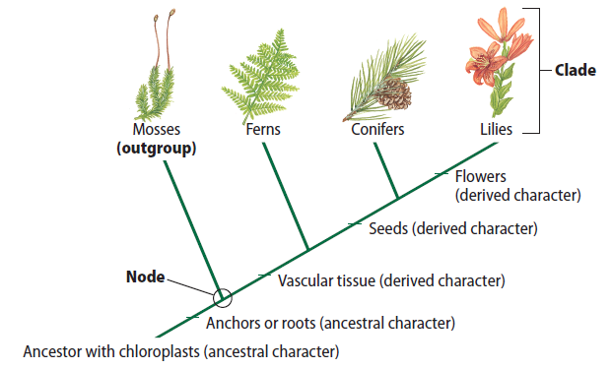
Phylogenetic Reconstruction
Cladograms
A cladogram is a branching diagram that represents a proposed phylogeny of a species or group.
One branch of a cladogram is called a clade.
Modern Classification
Copyright © McGraw-Hill Education

Slide 14
Phylogenetic Reconstruction
Cladograms
To construct a cladogram, groups of interest need to be compared to an outgroup, which has more ancestral characteristics.
The cladogram is constructed by sequencing the order in which derived characters evolved with respect to the outgroup.
The more derived characteristics two groups share, the more recently the groups shared a common ancestor.
Modern Classification
Copyright © McGraw-Hill Education

Slide 15
Constructing a Cladogram
Animation
FPO Add link to animation from page 496 (figure 11) here.
Modern Classification
Copyright © McGraw-Hill Education

Slide 16
Visualizing the Tree of Life
Animation
FPO Add link to animation from page 497 (Figure 12) here.
Modern Classification
Copyright © McGraw-Hill Education

Slide 17
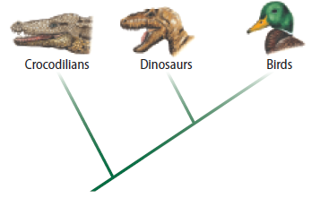
Phylogenetic Reconstruction
The tree of life
Darwin used an analogy of a tree to suggest that all species developed from one or a few species.
The term tree of life was coined in the nineteenth century to describe a diagram showing all living organisms.
A complete and accurate tree of life would benefit researchers in industry, agriculture, medicine, and conservation.
Modern Classification
Copyright © McGraw-Hill Education

Slide 18
Review
Essential Questions
What are the similarities and differences between species concepts?
What are the methods used to reveal phylogeny?
How is a cladogram constructed?
Vocabulary
phylogeny
character
molecular clock
cladistics
cladogram
Modern Classification
Copyright © McGraw-Hill Education

