Slide 1
Section 1: The History of Classification
Biologists use a system of classification to organize information about the diversity of living things.
K What I Know | W What I Want to Find Out | L What I Learned

Slide 2
Essential Questions
What are the similarities and differences between Aristotle’s and Linnaeus’s methods of classification?
Using binomial nomenclature, how are scientific names written?
What are the categories used in biological classification?
The History of Classification
Copyright © McGraw-Hill Education

Slide 3
Vocabulary
Review
morphology
New
classification
taxonomy
binomial nomenclature
taxon
genus
family
order
class
phylum
division
kingdom
domain
The History of Classification
Copyright © McGraw-Hill Education

Slide 4
Early Systems of Classification
Classification is the grouping of objects or organisms based on a set of criteria.
Biologists use a system of classification to organize information about the diversity of living things.
The History of Classification
Copyright © McGraw-Hill Education

Slide 5
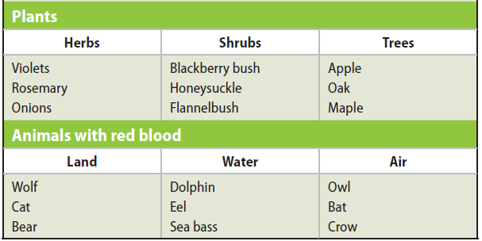
Early Systems of Classification
Aristotle’s system
More than 2,000 years ago, Greek philosopher Aristotle developed the first widely accepted classification system.
Classified organisms as plants or animals
Animals divided into “red blooded” and “bloodless”, then by habitat
Plants divided by average size and structure
The History of Classification
Copyright © McGraw-Hill Education

Slide 6
Aristotle’s Classification System
Interactive Table
FPO Add link to interactive table from page 484 (table 1) here.
The History of Classification
Copyright © McGraw-Hill Education

Slide 7
Early Systems of Classification
Linnaeus’s system
Linnaeus’s system of classification was based on observations of morphology and habitat.
The Linnaean system was the first formal system of taxonomy – the discipline of identifying, naming, and classifying organisms.
The History of Classification
Copyright © McGraw-Hill Education

Slide 8
Early Systems of Classification
Binomial nomenclature
Linnaeus’s method of naming organisms, called binomial nomenclature, gives each species a scientific name with two parts.
The first part is the genus name, and the second part is the specific epithet, or specific name, that identifies the species.
Biologists use scientific names for species because common names vary in their use.
The History of Classification
Copyright © McGraw-Hill Education

Slide 9
Early Systems of Classification
Binomial nomenclature
When writing a scientific name, scientists use these rules:
The first letter of the genus name always is capitalized, but the rest of the genus name and all letters of the specific epithet are lowercase.
If a scientific name is written in a printed book or magazine, it should be italicized.
When a scientific name is written by hand, both parts of the name should be underlined.
After the scientific name has been written completely, the genus name will be abbreviated to the first letter in later appearances (e.g., C. cardinalis).
The History of Classification
Copyright © McGraw-Hill Education

Slide 10
Early Systems of Classification
Modern classification systems
Modern classification is rooted in the Linnaean system.
As the study of evolution grew, scientists began using evolutionary relationships in their classification systems.
The History of Classification
Copyright © McGraw-Hill Education

Slide 11
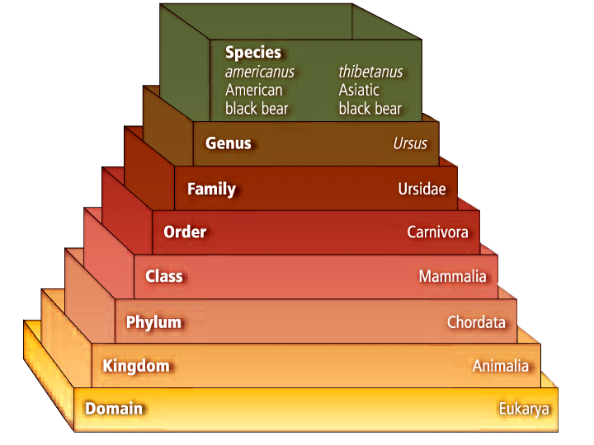
Taxonomic Categories
The taxonomic categories used by scientists are part of a nested-hierarchal system.
Each category is contained within another, and they are arranged from broadest to most specific.
The History of Classification
Copyright © McGraw-Hill Education

Slide 12
Taxonomic Categories
Species and genus
A named group of organisms is called a taxon.
A genus is a group of species that are closely related and share a common ancestor.
Family
A family is the next higher taxon, consisting of similar, related genera.
The History of Classification
Copyright © McGraw-Hill Education

Slide 13
Taxonomic Categories
Higher taxa
An order contains related families.
A class contains related orders.
A phylum or division contains related classes.
A kingdom contains related phyla.
The domain is the broadest of all the taxa and contains one or more kingdoms.
The History of Classification
Copyright © McGraw-Hill Education

Slide 14
Systematics applications
Taxonomy is part of a larger branch of biology called systematics.
Systematics is the study of biological diversity with an emphasis on evolutionary history.
Taxonomists can produce detailed guides to identify different organisms.
Through the use of dichotomous keys, which provide a series of choices between alternate characteristics, users can identify organisms they encounter.
The History of Classification
Copyright © McGraw-Hill Education

Slide 15
Review
Essential Questions
What are the similarities and differences between Aristotle’s and Linnaeus’s methods of classification?
Using binomial nomenclature, how are scientific names written?
What are the categories used in biological classification?
Vocabulary
classification
taxonomy
binomial nomenclature
taxon
genus
family
order
class
phylum
division
kingdom
domain
The History of Classification
Copyright © McGraw-Hill Education

