Slide 1

Section 3: The Human Genome
Genomes contain all of the information needed for an organism to grow and survive.
K What I Know | W What I Want to Find Out | L What I Learned

Slide 2
Essential Questions
What are the components of the human genome?
How do forensic scientists use DNA fingerprinting?
How can information from the human genome be used to treat human diseases?
The Human Genome
Copyright © McGraw-Hill Education

Slide 3
Vocabulary
Review
codon
New
DNA fingerprinting
bioinformatics
DNA microarray
single nucleotide polymorphism
haplotype
pharmacogenomics
gene therapy
genomics
proteomics
The Human Genome
Copyright © McGraw-Hill Education

Slide 4
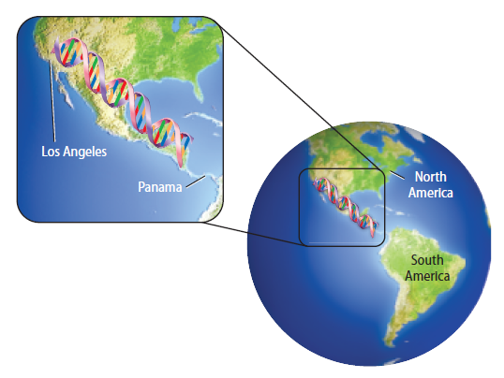


The Human Genome Project
The goal of the Human Genome Project (HGP) was to determine the sequence of the approximately three billion nucleotides that make up human DNA and to identify all of the approximately 20,000-25,000 human genes.
The Human Genome
Copyright © McGraw-Hill Education

Slide 5
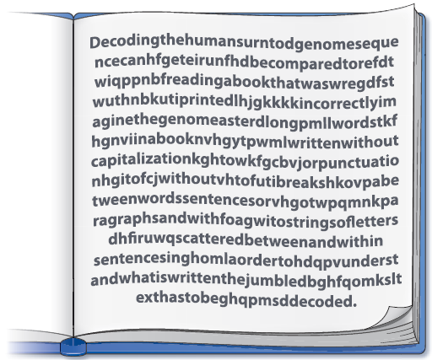
The Human Genome Project
Sequencing the genome
The 46 chromosomes were fragmented, combined with vectors, cloned, and sequenced using automated sequencing machines.
After sequencing, scientists observed that less than two percent of all the nucleotides code for all the proteins in the body.
The genome is filled with long stretches of noncoding sequences.
The Human Genome
Copyright © McGraw-Hill Education

Slide 6
Gene Splicing
Virtual Lab
FPO Add link to Virtual Lab from page 373 here.
The Human Genome
Copyright © McGraw-Hill Education

Slide 7
The Human Genome Project
DNA fingerprinting
The long stretches of noncoding regions of DNA are unique to each individual.
DNA fingerprinting involves separating the noncoding fragments to observe the distinct banding patterns that are unique to every individual.
The Human Genome
Copyright © McGraw-Hill Education

Slide 8
Identifying Genes
After sequencing the human genome, scientists began the process of identifying the genes and their functions.
For organisms without large noncoding regions, researchers have identified genes by scanning the sequence for Open Reading Frames (ORFs).
ORFs contain at least 100 codons that begin with a start codon and end with a stop codon.
The Human Genome
Copyright © McGraw-Hill Education

Slide 9
Bioinformatics
The Human Genome Project and other sequencing projects produce enormous amounts of data.
Bioinformatics involves creating and maintaining databases of biological information.
Researchers analyze sequences, looking for genes and predicting the structures of newly discovered proteins.
The Human Genome
Copyright © McGraw-Hill Education

Slide 10
DNA Microarrays
Gene expression can be analyzed using DNA microarrays, tiny microscope slides or silicon chips that are spotted with DNA fragments
Help researchers determine whether the expression of certain genes is caused by genetic factors or environmental factors
The Human Genome
Copyright © McGraw-Hill Education

Slide 11
Visualizing Microarray Analysis
Animation
FPO Add link to animation from page 377 (Figure 15) here.
The Human Genome
Copyright © McGraw-Hill Education

Slide 12
The Genome and Genetic Disorders
Variations in the DNA sequence that occur when a single nucleotide in the genome is altered are called single nucleotide polymorphisms or SNPs.
For a variation to be considered an SNP, it must occur in at least one percent of the population.
The Human Genome
Copyright © McGraw-Hill Education

Slide 13
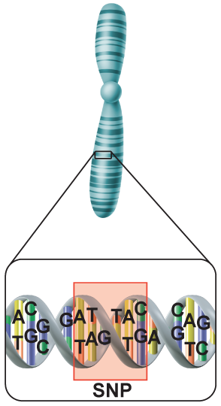
The Genome and Genetic Disorders
The HapMap project
Regions of linked variations in a genome are known as haplotypes.
An international group of scientists is creating a catalog of common genetic variations that occur in humans.
Assembling the HapMap involves identifying groups of SNPs in a specific region of DNA.
The Human Genome
Copyright © McGraw-Hill Education

Slide 14
The Genome and Genetic Disorders
Pharmacogenomics
The study of how genetic inheritance affects the body’s response to drugs is called pharmacogenomics.
The benefits of pharmacogenomics include more accurate dosing of drugs that are safer and more specific to individuals.
The Human Genome
Copyright © McGraw-Hill Education

Slide 15
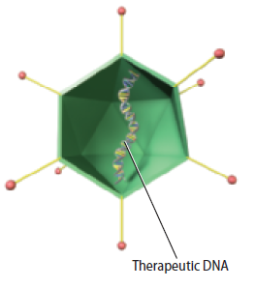
The Genome and Genetic Disorders
Gene therapy
Gene therapy is a technique aimed at correcting mutated genes that cause human diseases.
Scientists insert a normal gene into a chromosome to replace a dysfunctional gene.
The Human Genome
Copyright © McGraw-Hill Education

Slide 16
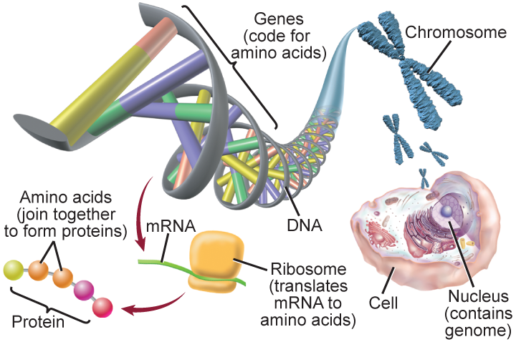
Genomics and Proteomics
Genomics is the study of an organism’s genome.
Involves identifying genes and proteins produced by these genes
Proteomics is the large-scale study and cataloging of the structure and function of proteins.
The Human Genome
Copyright © McGraw-Hill Education

Slide 17
What’s BIOLOGY Got To Do With It?
Video
FPO Add link to video from page 379 here.
The Human Genome
Copyright © McGraw-Hill Education

Slide 18
Review
Essential Questions
What are the components of the human genome?
How do forensic scientists use DNA fingerprinting?
How can information from the human genome be used to treat human diseases?
Vocabulary
DNA fingerprinting
bioinformatics
DNA microarray
single nucleotide polymorphism
haplotype
pharmacogenomics
gene therapy
genomics
proteomics
The Human Genome
Copyright © McGraw-Hill Education

