Slide 1
Introduction to the world of hydroponic gardening
Presented by:

Slide 2
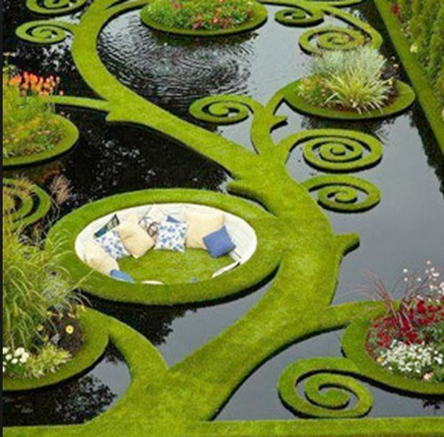
Hydroponic - Working Water
Hydroponics, aeroponics and aquaponics are a subset of hydroculture and are methods of growing plants using mineral nutrient solutions, in water, without soil.

Slide 3
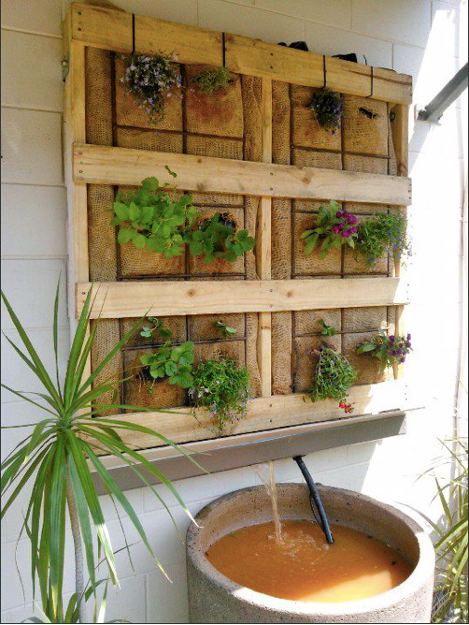
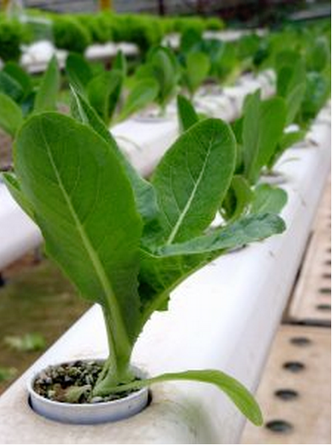
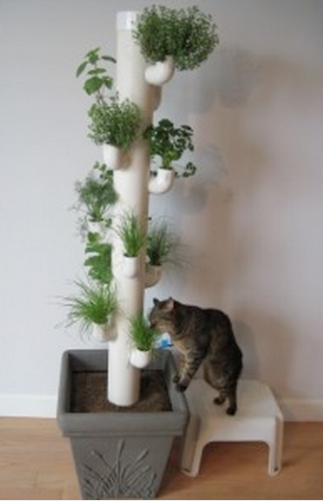
Hydroponics Yesterday – Today - Tomorrow

Slide 4
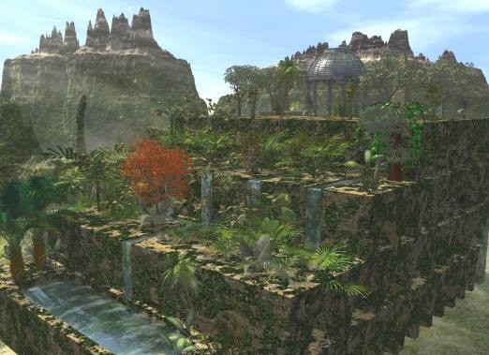
The Past… Hanging Gardens Of Babylon
The famed Hanging Gardens of Babylon are believed to have been one of the first mass scale hydroponic projects.
Located in Babylonia or Mesopotamia The Hanging Gardens of Babylon were built around 600 B.C., commissioned by King Nebuchadnezzar II.
The water was sourced from the Euphrates River.
These gardens are one of the 7 Wonders of the Ancient World.

Slide 5
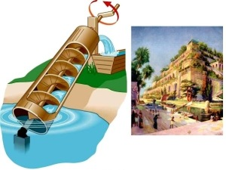
The Past… Hanging Gardens Of Babylon
They operated very similar to a vertical wall garden.
Water was pumped from the Euphrates River to the top of the gardens and then trickled down, eventually ending back in the reservoir, or according to this illustration, a pool.

Slide 6
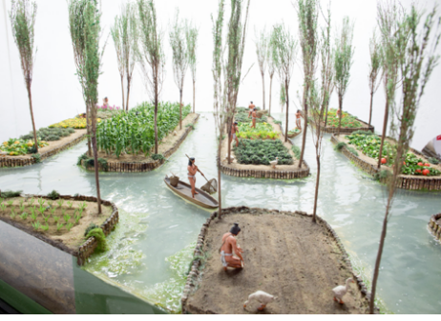
The Past… Chinampas - “Floating Islands”
The Aztec’s were tremendous thinkers, scientists, engineers and designers.
Living on the marshy edges of Lake Tenochtitilan, in what is now Mexico, they devised a sophisticated farming system built on artificial “floating islands.”

Slide 7
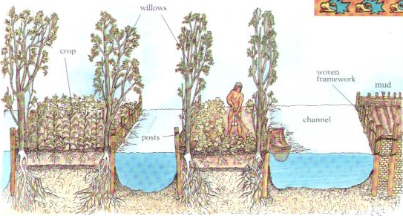
The Past… Chinampas - “Floating Islands”
The shallow lake bed was staked out, roughly 98 feet by 8.5 feet, and fenced in with wattle a sticky combination of mud, clay and animal dung.
Organic material, silt and mud from the lake bed was dredged up and piled on the Chinampas until it rose above the water line.
Willow trees were often planted in the corners to secure the edges.
Chinampas were separated by channels wide enough for canoes to easily navigate.
Chinampas were often polyculture, imitating the diversity of a natural ecosystem.

Slide 8
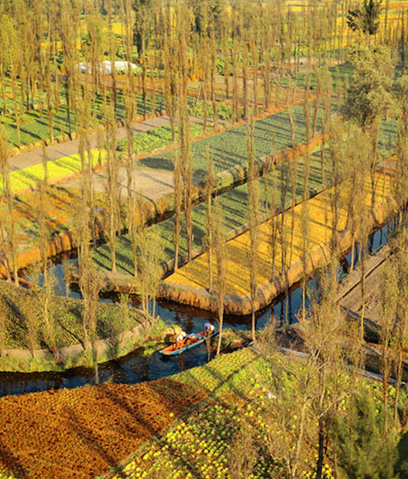
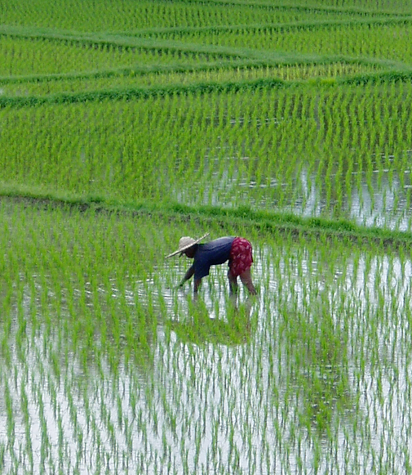
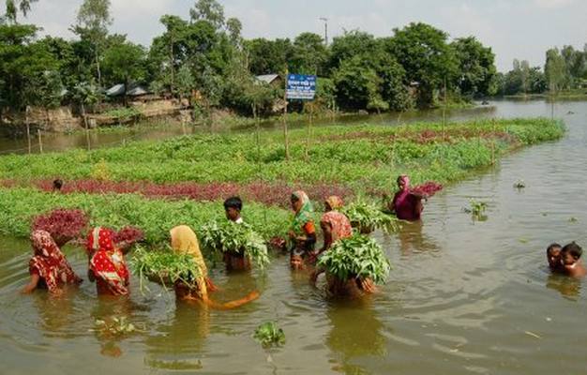
The Present… Around the World
Australia
Bangladesh
Bali
The same concept is in use today where floating farms are giving hope to farmers along rivers in Bangladesh, and other areas around the world, that have been hit by massive flooding in recent years.

Slide 9
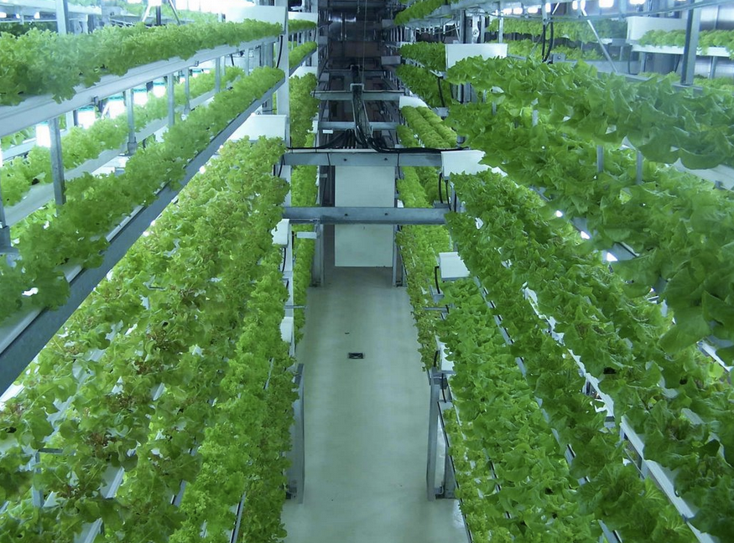
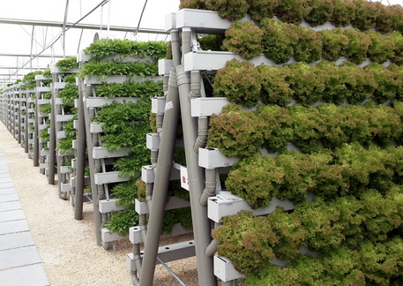
The Present… Large Scale Hydroponic Farming
Large scale hydroponic farming is in use around the world to grow the produce that we eat.

Slide 10
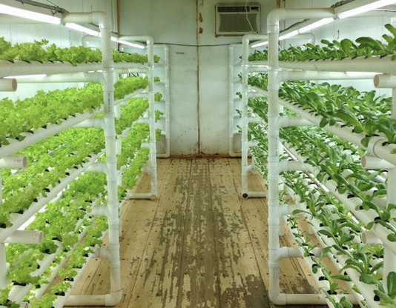
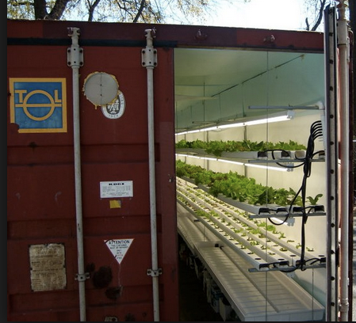
The Present… Hydroponic Farming Today
Shipping containers are being repurposed to create mobile local farms allowing for produce to be grown in the area where is will be consumed where typical farm land may not be available
http://podponics.com/

Slide 11
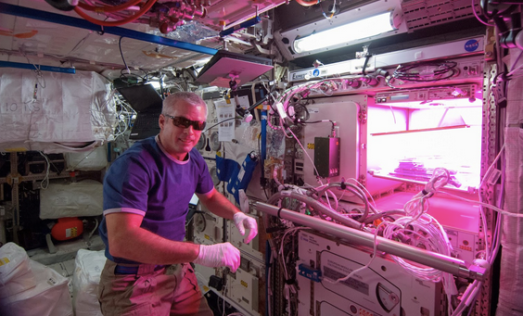
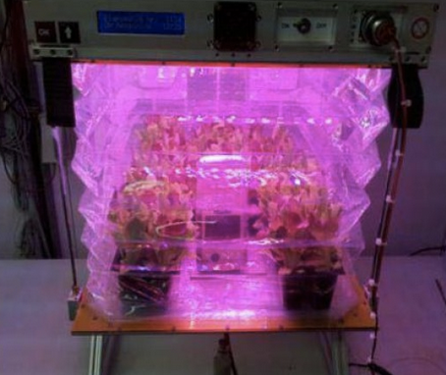
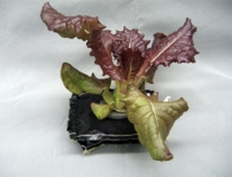
The Present… Hydroponic Farming in Space
The Veggie system will expand fresh food production in space.
Rooting pillows made of Teflon-coated Kevlar and Nomex, hold the planting media and nutrients. The rooting pillows are either preloaded with seeds or astronauts inserts them in space.
The system is adjustable; as the plant grows the pillow expands.
A water reservoir located below the pillows and a root mat add water through capillary action.
Energy efficient LEDs emit blue, red and green light, producing the spectrum plants need to thrive.
Astronaut Steve Swanson activates the Veggie on the ISS, May 2014

Slide 12
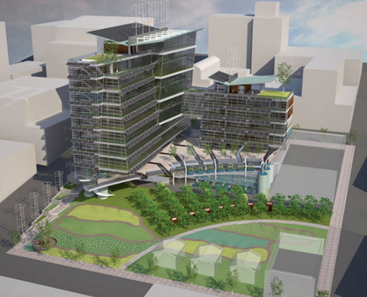
The Future… Vertical Hydroponic Farming
It is estimated that by 2050 the world’s population will have boomed to 9.1 billion people.
According to the UN food production will need to increase by 70%.
A pioneer in this field of sustainability, Dickenson Despommier, a micro-biologist and ecologist at Columbia University’s School of Public Health, sees vertical farming as the answer to this problem.

Slide 13
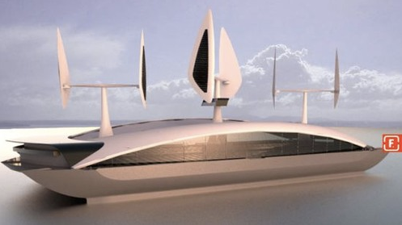
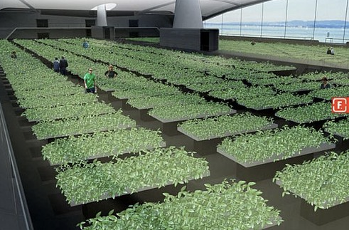
The Future… Equinox Farming Ship (concept design)
Engineers and designers are turning towards our vast oceans for solutions to support food needs for the expanding world population.
Equinox farming ships are designed to be self-sufficient and carbon-neutral; they will be powered by solar and wind energy; crops will be grown hydroponically using seawater that has gone through a desalinization process.

Slide 14
Interested in introducing a hydroponic garden at home? Consider this…
1. Do you enjoy fresh basil, mint, cilantro, parsley, kale, baby spinach and microgreens?
Do you want to enjoy the benefits of gardening all year around, regardless of the weather outside?
If so....
Look around your home and determine the space available.
No matter how small or large the space, there is a perfect system for it.
Read the book Hydroponics Basics – The Basics of Soilless Gardening Indoors by George F. Van Patten. It covers the basics of creating a successful hydronic garden.
Visit Delicious Gardens for a personalized consultation to gather the tools needed for successful, food-grade, hydroponic gardening at home

Slide 15
THANK YOU!!
DeliciousGardensNY.com
facebook.com/DeliciousGardens
twitter.com/Delishgardens
info@DeliciousGardensNY.com
180 Route 117 Bypass Road – Bedford Hills, NY 10507
914.864.1400
Please contact us for private shopping and consultations appointments.

Slide 16
Thank you for visiting Delicious Gardens Notes

