Slide 1
ETHNOBOTANY: Plants Useful to Man
Santa Fe botanical Garden docents
Mollie S. Toll
Museum of new mexico
Office of archaeological studies
April 4, 2016

Slide 2
Southwestern Ethnobotany
Studied ethnographically since the late 1800s
Matilda Coxe Stevenson
Frank Cushing
Edward Castetter led a broad effort at UNM in the 1930s-1940s
Archaeological evidence lends a time dimension
Focus on spectacular dry shelter assemblages (late 1800s to present)
Attention to humbler remains from a broader range of sites, with the advent of flotation in the 1960s

Slide 3
What Destroys Plant Remains
Freezing and thawing
Wetting and drying
Decomposition

Slide 4
What Preserves Plant Remains
Low humidity
Deeply buried deposits
Protected deposits
Caves, shelters, intact roofs

Slide 5
Approaches to Ethnobotany
Adding breadth and time depth to understanding of human history
Examining human adaptations to the landscape
Considering physical attributes of plants as resources
Concentrated storage of carbohydrates, fats, oils
Defensive chemicals
Fibers
Lignified tissues
Thinking about human nutrition
Food as fuel: demographics
Food as taste: defining cultures and calendars

Slide 6
What Plants Have Truly Broad Applications
Utilized at all site types, all time periods, from the earliest hunter gatherers to traditional villages of the 20th c
Surprisingly, these are largely lowly weeds, or plants with an adaptive advantage under disturbed conditions

Slide 7
Chenopodium spp. Goosefoot or Quelites

Slide 8
Amaranthus spp. Pigweed

Slide 9
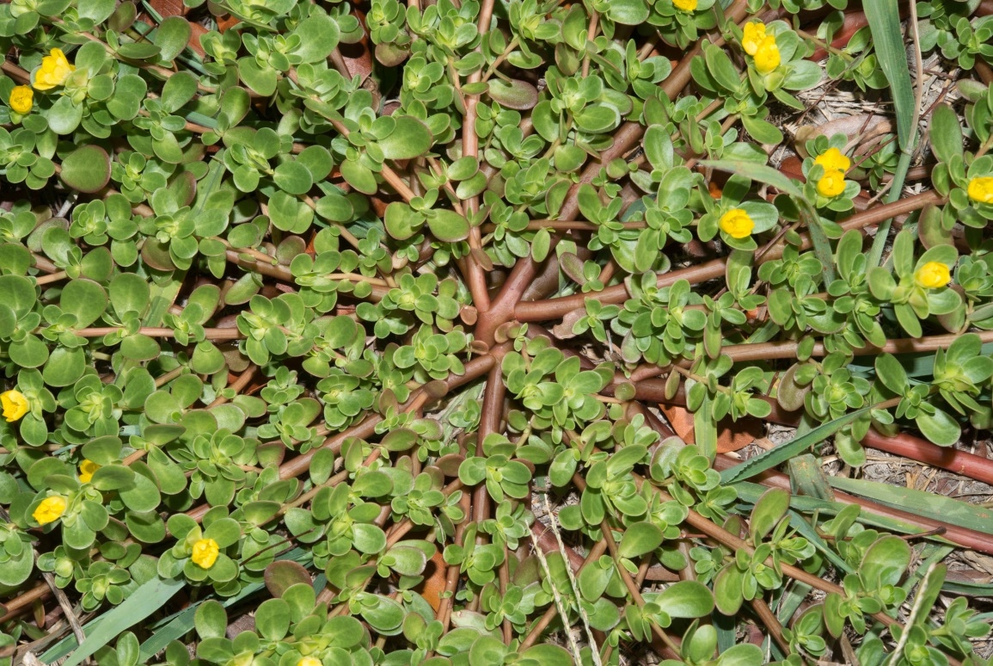
Portulaca spp. Purslane, or verdolagas

Slide 10
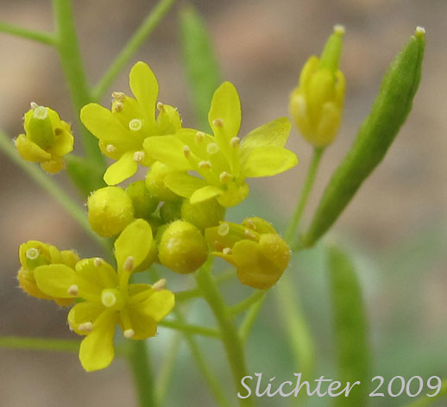
Descurainia or Tansymustard

Slide 11
Many Useful Perennials have more limited distribution
Sandy soils, dunes
Talus zones with some protection from drying winds, some water collection advantage
Riparian zones

Slide 12
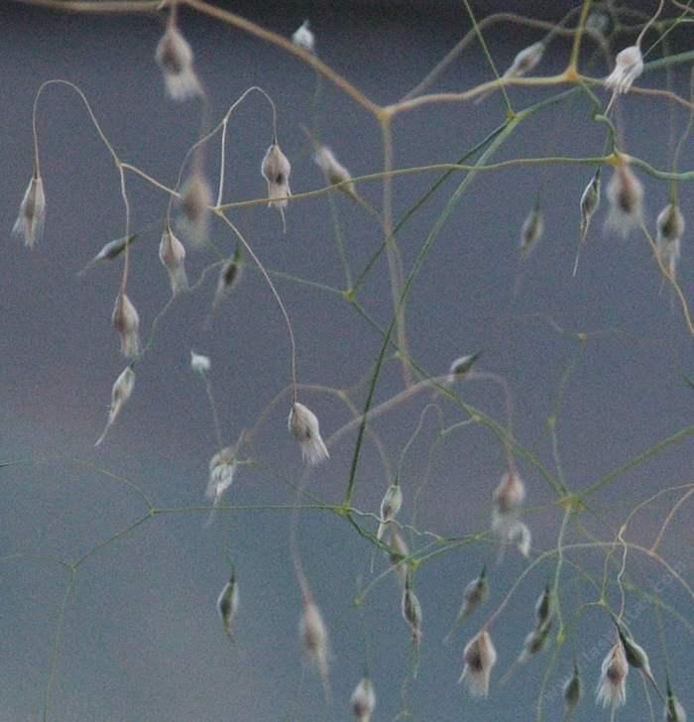
Achnatherum hymenoides Indian ricegrass

Slide 13
Platyopuntia spp. Pricklypear

Slide 14
Echinocereus spp. Hedgehog cactus

Slide 15
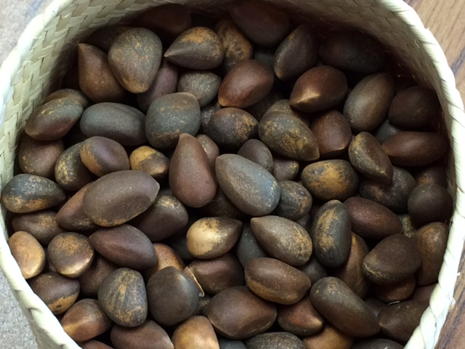
Piñon Pinus edulis

Slide 16
Juniperus Juniper

Slide 17
Yucca elata Narrow leaf yucca

Slide 18
Yucca baccata Broadleaf yucca

Slide 19
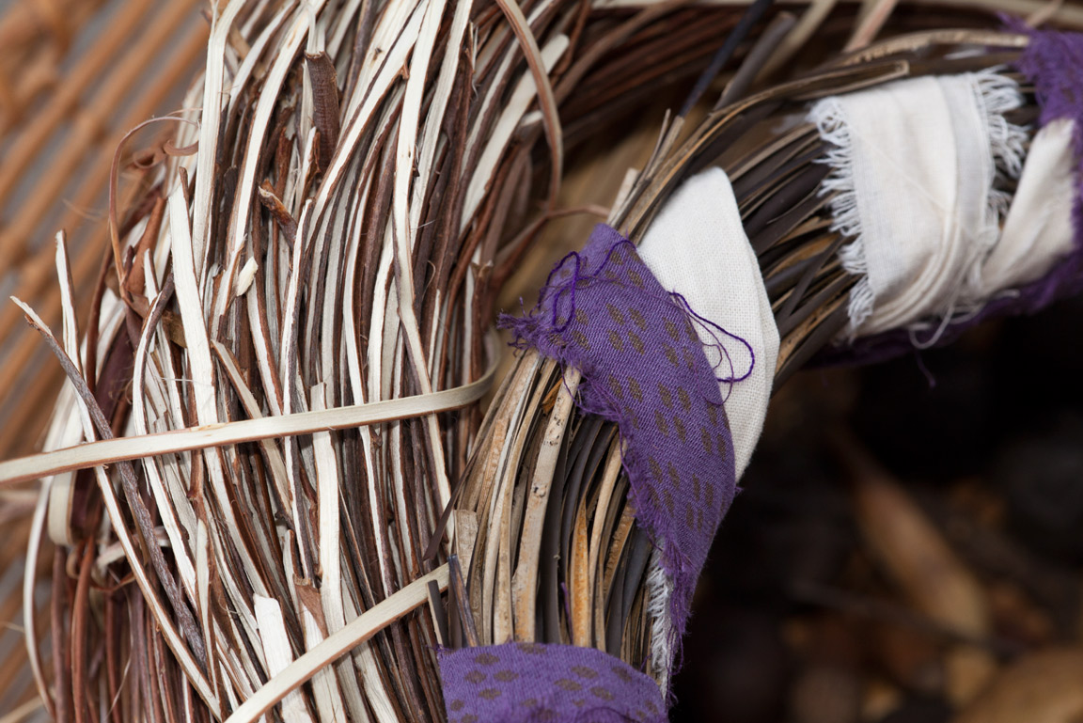
Rhus trilobata Three-leaf sumac or squawberry

Slide 20
Medicinals
Carbohydrates [sometimes store alkaloids, acrids]
Mucilage [a slimy, moist polysaccharide]
Glycosides [sugar + a-glycones]
Sulfur glycosides [mustards, onion]
Phenol glycosides [salicylin]
Flavinoids [berries] [safe for people/ animals, toxic to microorganisms]
Saponins [yucca root]

Slide 21
More Medicinals
Acids
Tannic acid [astringent]
Oxalic acid [purslane, rhubarb, cheno-ams, buckwheat]
Acrids [mustards, radish, horseradish, some parsley family
Alkaloids [>5000, more common in hot climates]
Glycoside alkaloids [nightshade family]

