Slide 1
Interpreting the Periodic Table
Review so your brain can retain!!!

Slide 2
What you need is . . .
Copy of the periodic table
Pencil
Colored pencils or crayons
(red, blue, green, purple)
Brain
Periodic table from your agenda

Slide 3
Remember that groups/families on the periodic table are the columns of elements
Li
Na
K
Rb
Cs
Fr

Slide 4
Remember that periods of elements go across the table. Think about writing a sentence, you write from left to write and put a period at the end.
K | Ca | Sc | Ti | V | Cr | Mn | Fe | Co | Ni
This is the beginning of period 4

Slide 5
When the man in the upcoming video talks about “not as bright” going from “left to right” (on the periodic table) he is referring to the LUSTER of the elements.

Slide 6
WATCH THIS VIDEO

Slide 7
Metals & Non-metals
Separate the periodic table into metals and non-metals
Find the “stair step” line
Draw a left arrow to the left of the stair step line and write the word “metals”
Draw a right arrow to the right of the stair step line and write the word “non-metals”

Slide 8
Identify the Metalloids
Lightly shade the metalloids purple
Boron, Silicon
Across
Down
Ge
As
Sb
Te
Po

Slide 10
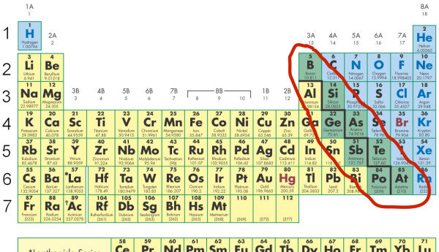

Slide 11
Hydrogen
Draw a circle around Hydrogen and draw an up arrow to show that you are separating the element from the rest of the group
Hydrogen does not have any similar properties with the elements in group one; it is placed in the same column because it only has one valence electron
Why is this homie hangin’ in the group 1 crib?

Slide 12
Label Group 1 – Alkali Metals
Lightly shade group 1 elements green
GO!!!!!! And REACT!!!!
Group one elements are extremely chemically reactive.
The elements are more reactive the further down the group you move.
Group one elements only have 1 valence electron, these elements often give away this electron to become stable

Slide 13
Label Group 2-Alkaline Earth Metals
Stripe group 2 elements with green
GO!!!! AND REACT!!!!!
Group 2 metals are chemically reactive (not as extreme as group 1, but still highly reactive)

Slide 14
Label Group 17-Halogens
Lightly shade group 17 elements green
GO!!!!!! And REACT!!!!
Group 17 elements are extremely chemically reactive.
These elements have 7 valence electrons and only need 1 more to be stable.
These elements often reactive with group 1 Alkali Metals (7+1=8 stable ). When these elements react with group 1 metals they form salts.

Slide 15
Label Group 18-Noble Gases
RED-AT A STOP!-UNREACTIVE
Lightly shade group 18 red
Noble gases are not reactive (stable) because they have full energy levels

Slide 16
Transition Metals-Groups 3-12
Draw a bracket above groups 3-12
Label above the bracket “Transition Metals”
Stripe these elements blue
Don’t forget this includes the Lanthanide & Actinide Series
Transition metals have varied reactivity

Slide 17
Lanthanide & Actinide Series
Draw a bracket beside these two series of elements
Label the bracket “Rare Earth Metals”
Draw an arrow to the Actinide Label and write ALL Radioactive

Slide 18
Other Metals
Label the remaining metals with blue dots (varied reactivity)
Al, Ga, In, Tl, Pb, Bi, Sn
Draw a star beside Aluminum to indicate that this element is the most abundant metal found on the Earth

Slide 19
Other Non-metals
Label the remaining non-metals with blue triangles (varied reactivity)
C, N, O, P, S, Se

Slide 20
Valence Electrons
Write a “V” under each group #
This is to remind you that the group # tells you the number of valence electrons the elements in that group contain.
The # of valence electrons an element has affects the atom’s chemical reactivity

Slide 21
Valence Electrons
Remember Valence Electrons are the electrons on the outermost energy level
For double digit group numbers, the number in the ones place tells you the # of valence electrons (ex. 17, 7 valence electrons)
EXCEPTION-He (only has 2 valence electrons) however, since the first energy level only holds 2 electrons the element is stable like the rest of the noble gases in group 18

Slide 22
Energy Levels
Draw a square around the period numbers
Next to one of the squares write the label “energy levels”
The period number tells you the number of energy levels the elements in that period contain
Energy levels affect an element’s chemical reactivity

